Slide 1

What's actually working
with AI in recruitment right now
Josh O'Loughlin · Tech2Rec
Notes:
Hi everyone, I'm Josh - I run Tech2Rec, we're an IT provider that works exclusively with recruitment agencies across Australia and the UK, and I'm here today to talk to you about what’s actually working with AI in recruitment right now.

Slide 2
What we'll cover
1
Who I am, and how I got here
2
Why most AI implementations don't work
3
The right order to actually get results
Notes:
So I'll just quickly cover what we'll run through today: we’ll touch on who I am and how I got here, why most AI implementations don't work for recruitment agencies, and the right order for implementing AI to actually get results, as well as a bunch of examples for you. James had some great practical examples but there’s so much you can do, it’s hard to know WHAT to do or where to start. So my promise to you is that by the end of this call, you’ll have a roadmap that you can follow to implement AI in your business.

Slide 3

Like most people in recruitment, I didn't plan to end up here.
I finished a computer science degree, then worked at a trading card store for two years.
Notes:
Like a lot of people in recruitment, I didn't plan to end up here. I came out of uni at the beginning of 2020 with a computer science degree and then did absolutely nothing with it. I went and worked at a trading card store for a couple of years and sold Pokemon and sports cards. It was great fun, just not exactly what the degree was for. And while I was doing that, my dad had been running his own IT business.

Slide 4

Dad had been running his own IT business for twenty years.
The business had grown and he was running it on his own, so I came on to help out.
A couple of years in, he handed the business over to me.
Which meant I had to figure out how to actually run the thing.
Notes:
He'd been at it for about twenty years down in Melbourne, running it completely on his own. Business had grown to the point where he needed a hand, so I came on board to help out. A couple of years in, it became clear that I was going to be the one running it long-term anyway, he handed the business over to me so I could take the business in the direction I wanted to. Which meant at 25 or 26 I suddenly needed to figure out how to actually run a business! So I went looking for people who'd done it well that I could learn from.

Slide 5
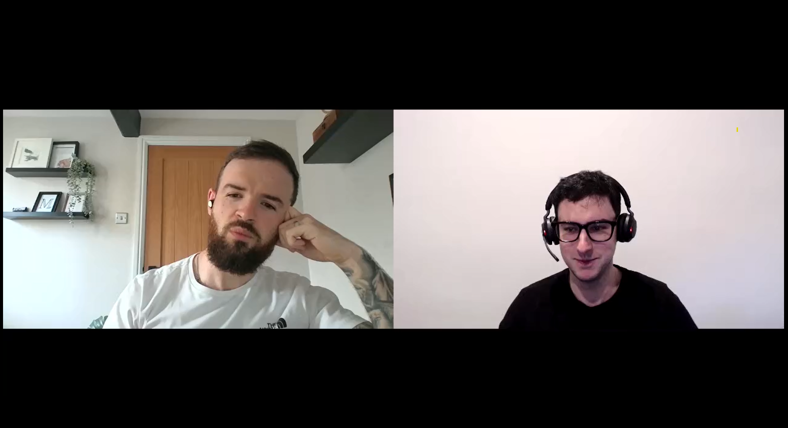
So I went looking for people who'd done it well.
I joined a community of IT providers, and Tom clearly knew what he was doing.
He was running a generalist IT business, invisible in a crowded market.
So he picked one industry and went all in on recruitment.
It worked.
Notes:
I joined a community of IT providers, and a guy called Tom Brennan stood out to me. He’d been running a generic IT business over in the UK that was invisible in a crowded market, so he decided to niche into one industry to stand out. He looked at his own client base, saw recruitment was where he already had the most clients, and leaned all the way in. It went amazing, a year later he rebranded the business as Tech2Rec. He ended up becoming my business mentor for the next year or so, teaching me about sales, marketing, and positioning. And that mentorship took us somewhere neither of us expected.

Slide 6

That mentorship took us somewhere neither of us expected.
Tom's business grew and he started looking to expand.
His first instinct was the US.
I said, what about Australia instead?
Long story short, that became Tech2Rec Australia.
Notes:
His business had grown a lot and he was looking to expand. His first instinct was the US. I said, have you thought about Australia instead? Long story short, our business became Tech2Rec Australia, and that’s how we got here.

Slide 7
Now I spend most of my time talking with recruitment agencies.
And I keep seeing the same mistake.
Notes:
So now I spend most of my time talking to recruitment agencies, as clients and prospects but also just any agency that wants to talk through their tech stack or their IT or AI strategy for the business. And I keep seeing the same mistake being made when it comes to how agencies are going about implementing AI.

Slide 8
They want results, so they think...
Let's throw AI at the stuff that drives revenue - sourcing, outreach, BD.
“More activity, more results, right?”
Notes:
They want results, so they think, let's throw AI at the business functions that drives revenue. Things like sourcing, outreach, BD. They think that more activity in those areas is gonna drive more results for the business, so they think it’s the best place to start. Seems fair enough, right?

Slide 9
Going after revenue first usually slows you down
Sourcing, outreach and BD all run off your data.
If the data's wrong, you'll be chasing dead leads at ten times the speed.
Notes:
Except it usually does the opposite of what people are hoping for. Going after the revenue stuff first tends to slow you down, and the reason is that all of that stuff runs off your data. So say you point AI at finding leads. It's fast, it's pulling in roles and hiring managers all day. But if your contact data's out of date, you're now chasing leads that went cold months ago, and you're doing it at ten times the pace. . Or you could point AI at outreach, but if there's no real conversation history in the CRM for it to work from,it's got nothing to personalise your outreach with and you’ll be spamming out generic messages to people.
AI doesn’t just magically fix that without being told to, it just works off whatever you've already got. Which is why the order you do this in actually matters.

Slide 10
Three stages of the AI journey
1
?
2
?
3
?
Notes:
So what's the right way to actually think about implementing AI in a recruitment agency? We think about it in three stages.

Slide 11
Three stages of the AI journey
1
Automate the admin
2
?
3
?
Notes:
Stage one is automating the admin, the repetitive stuff that eats your week, like notes, CRM updates, candidate data.

Slide 12
Three stages of the AI journey
1
Automate the admin
2
An AI assistant connected to everything
3
?
Notes:
Stage two is where everyone in the business gets an AI assistant (Claude, ChatGPT, etc) that actually knows what's going on. It's connected to all your systems, so you can get information quickly and get it take action on things for you.

Slide 13
Three stages of the AI journey
1
Automate the admin
2
An AI assistant connected to everything
3
The whole thing runs itself
Notes:
And stage three is where AI starts doing things without you having to even ask. Work just happens in the background off the back of what you're already doing. We'll come back to stage 2 and 3 and see what they looks like properly later.

Slide 14
Three stages of the AI journey
1
Automate the admin
2
An AI assistant connected to everything
3
The whole thing runs itself
Notes:
But for now let's start with stage one, automating the admin. This is where we'll spend most of our time today, because it's the foundation everything else sits on.
I'm going to walk through five examples we see come up a lot. They're examples though, not a checklist. Every agency's different, so as we go, have a think about what's actually eating the most hours in your week, or your team's, that doesn't really need anyone's judgement, just their time. That’s going to be a great place to start with AI, even if it’s something I don't mention.
One thing worth saying though. Your data is the foundation, so the first two examples are both about getting that right. Everything after that only really works once it's sorted.

Slide 15
Example 1/5: Call & meeting notes
The problem
You're writing notes while trying to listen.
And even good notes only capture what felt important at the time.
Notes:
Example one is call and meeting notes. A lot of you will know this one. You're on a call, and the second it ends you're writing up notes, sending a follow-up, and hopefully updating the CRM.
Some people are good at taking notes while they're on the call, but for most it's distracting because you're half paying attention and half writing.
But it's not just about time. Even if you're great at it, you're never capturing the whole conversation. You're choosing what feels important in the moment and everything else is gone. Some throwaway comment a candidate makes which might be useful later on won't make the cut. And multiply that by every call, every day, for every consultant.

Slide 16
Example 1/5: Call & meeting notes
What to do
Record it, transcribe it, log it automatically.
Nothing gets lost, and nobody types anything up.
Notes:
So how do we fix it? Every call and every meeting gets recorded, transcribed, and summarised automatically. Nothing's lost, you've got the full conversation rather than whatever you managed to scribble down. And the notes and next steps land straight in the CRM, so nobody’s had to type anything up.

Slide 17
Example 1/5: Call & meeting notes
Watch out
Make it the default.
If it's only running on some calls, you've still got the same gaps.
Notes:
One thing worth watching out for. This only works if it's the default. Every call, every client conversation, across every channel. If it's optional, or it's running on the phones but not Teams or Zoom, you're back to the same gaps you started with.

Slide 18
Example 2/5: CRM data cleanup
The problem
Most CRMs are full of out of date information.
Contacts who've left, duplicates, half-filled records. It makes everything else harder.
Notes:
Example two is your CRM data. Most agencies have databases with outdated contacts, duplicates, missing details. So either you're spending time fixing it manually, you stop trusting the CRM and work around it, or more commonly you just keep using it as is. That last one's the riskiest, because bad data slows you down and misleads you. You might call someone who left months ago, or pitch a role to a contact whose company's already filled it. And now you look like you're not paying attention.

Slide 19
Example 2/5: CRM data cleanup
What to do
Clean it once properly, then keep it clean.
A big upfront clean, then something running in the background from there.
Notes:
So this is an important one to fix, and there's two parts to it. First is a big upfront clean, where you go through everything that's built up over time and sorting out the issues.
Second is you have something running continuously after that, cleaning duplicates, updating contact details, and enriching records as things change.

Slide 20
Example 2/5: CRM data cleanup
Watch out
You need both types of cleanup.
Skip the upfront clean and it takes forever to catch up.
Skip the ongoing part and it drifts straight back.
Notes:
The thing to watch out for is only doing one of those cleanups.
If you skip the upfront clean, the ongoing process is going to take forever to catch up on years of mess. Skip the ongoing part and you're back where you started within a few months. You need both parts of the cleanup for it to work properly.

Slide 21
Example 3/5: CV formatting
The problem
Someone's manually reformatting every CV.
It takes no judgement, just time.
And what the client receives depends on who happened to do it.
Notes:
Example three, CV formatting. A candidate sends a CV through in whatever format they happened to use, and someone has to manually reformat it into your template before it goes to a client. It's tedious, it's repetitive, and it takes no judgement, just time. And because some people might do it slightly differently, what the client receives depends on who happened to pick it up.

Slide 22
Example 3/5: CV formatting
What to do
AI formats CVs into your template as it arrives.
Same standard every time, whoever's handling it.
A few hours of setup, then it just runs.
Notes:
So how do we fix it? We have AI reformat the CV into your branded template the moment it comes in, so nobody touches it manually. Same standard every time, no matter who’s handling it. There's a bit of setup upfront, as it might take a few hours to get your templates and branding configured in the system, but once that's done it just runs.

Slide 23
Example 3/5: CV formatting
Watch out
Build trust gradually.
Check the output for the first week or two, then you can leave it alone.
Notes:
One thing that’s worth doing early on though is checking the output, at least for the first week or two, just to build trust in it. Like anything AI generates, it's worth you double-checking things look right before it goes out. Then, once you've seen it get it right consistently, you can leave it alone.

Slide 24
Example 4/5: Job lead discovery
The problem
Hours lost crawling through job boards and LinkedIn.
And by the time you've found a role manually, it might’ve already done the rounds.
Notes:
Example four is job lead discovery, which is a bit more BD-related. A lot of agencies have consultants spending hours crawling through job boards, LinkedIn, company sites, hunting for leads.
Now everyone searches a bit differently, so coverage ends up inconsistent. But the bigger problem is timing. By the time you've found a role manually, it might’ve already done the rounds, other agencies have called, or the company's moved on to interviewing. When new leads crop up, we want to be able to find and act on them as quickly as possible.

Slide 25
Example 4/5: Job lead discovery
What to do
AI finds the roles and the hiring managers.
Not just the internal recruiter. Contact details and all, straight into your CRM.
Notes:
So how can we do this differently? We can have AI scan the web continuously, and get it to do more than just spot a role. It can find the actual hiring manager behind it, not just the internal recruiter, and pulls their contact details automatically. It can even flag which roles are under more pressure to fill, so you know where to prioritise time more effectively. And all of it can be dumped straight into the CRM, without anyone having to lift a finger.

Slide 26
Example 4/5: Job lead discovery
Watch out
Only works when your data is sorted first.
Otherwise a good lead just lands in the mess with everything else.
Notes:
Important thing here is that this one only really pays off once your CRM data's in good shape. Otherwise that great new lead just lands in a database full of duplicates and outdated contacts, and it's one more thing buried in the mess rather than something your team can act on. That's why the data cleanup comes first.

Slide 27
Example 5/5: Outreach support
The problem
Good outreach takes real time to write.
And follow-ups slip or get bumped when things get busy.
Notes:
Last one is outreach, and this one's a bit more controversial. Outreach is a tricky game. Writing something properly personalised takes real time, but if you lean on a template then it can come off as generic. And on top of that, follow-ups slip through the cracks either way, usually because they're sitting in a calendar reminder that keeps getting bumped when things get busy.

Slide 28
Example 5/5: Outreach support
What to do
Option one: AI drafts it.
Pulling from your CRM history, the job spec, past conversations. You review it and send.
Notes:
So there's two directions you can go here, and which one's right depends on your comfort level with AI. The first is AI-assisted, where AI drafts the message based on CRM history, the job spec, past conversations, and all the context it can draw from. Then the consultant reviews it, adjusts if they need to, and sends. So the thinking here is AI drafts, the human decides.

Slide 29
Example 5/5: Outreach support
What to do
Option two: systemise it instead.
No AI writing anything.
Just triggers and reminders so follow-ups don't rely on someone remembering.
Notes:
The second direction is systemising it instead. This doesn't have AI writing anything, and often it doesn't involve AI at all. It's a defined process, either written down or built out in a tool, with clear triggers for when a follow-up's due, tasks and reminders that don't rely on someone remembering, and working across whatever channels you use.

Slide 30
Example 5/5: Outreach support
Worth knowing
You can do both.
AI drafting the message, with the system underneath making sure it actually goes out on time.
Notes:
And these two options aren't either-or. You can still have AI drafting the message and still have the systemised process underneath making sure the follow-up actually goes out on time. They solve two different problems.

Slide 31
Example 5/5: Outreach support
Worth knowing
One thing we wouldn't do.
Let AI write and send outreach with nobody checking it first.
Notes:
There's technically a third option, which is letting AI write and send outreach on its own with no human involved. We don't recommend it, and we don't do it. The problem is you don't find out when it gets something wrong. It might have the wrong detail about a candidate, reference something that didn't happen, or just read a bit off, and the first you hear about it is when a client mentions it – not a great look.
Someone reading it before it goes out takes ten seconds and catches all of that, so if you want to involve AI in outreach, we draw the line at drafting messages thata human can then review and send. If you're not comfortable with AI writing anything at all, that's completely fine – that’s where that systemising path gets you most of the benefit without worrying about AI.

Slide 32
Example 5/5: Outreach support
Watch out
Same issue as before – you need good data.
Without decent notes and clean data, there's nothing real for AI to personalise with.
Notes:
And the thing to watch out for is the same issue as before, doing this without the foundation underneath. You’d only be bringing AI in so you can personalise quickly, but it can only personalise off what's actually in your CRM. If the notes and history aren't there, it's got nothing real to work with, so you’d just be generating generic outreach faster than you could write it yourself. Totally defeats the point, so you need to have the data piece sorted first.

Slide 33
It only works if it's the default.
I mentioned this earlier with call recording, but it’s true for all examples.
Do it sometimes, and you only get some of the benefit.
Notes:
But there's one more thing that'll decide whether any of this actually works. I mentioned it earlier with call recording, it only works if it's the default. Same goes for all of these, and any you’re able to come up with too. If you're only doing it sometimes, you only get some of the benefit.

Slide 34
So which ones can your team actually do, every time?
That's the real question, not just which bit of admin to tackle first.
Notes:
So as you're working out where to start, what to solve with AI first, the real question isn’t which bit of admin to tackle first, but which ones you can actually get your team doing, consistently, every time.

Slide 35
Three stages of the AI journey
1
Automate the admin
✓
2
An AI assistant connected to everything
3
The whole thing runs itself
Notes:
So that's stage one. You automate the admin, do it consistently, and then you’ll have built the foundation that everything else sits on. Which is what makes stage two possible.

Slide 36
Three stages of the AI journey
1
Automate the admin
✓
2
An AI assistant connected to everything
3
The whole thing runs itself
Notes:
So, onto stage 2. This is everyone in the business having an AI assistant plugged into all the tools - your inbox, your calendar, your CRM, your phone. So you can ask it anything and it pulls the answer from wherever it needs to, James already spoke a bit on the actions it can take for you, so I’ll talk a bit more about even just surfacing information as well as the important consideration you need to be aware of.

Slide 37
Stage 2
What this actually looks like
“Where's this deal actually at?”
“What did we talk about with this client last time?”
“Who haven't I followed up with this week?”
“Which candidates have I got sitting idle?”
“Draft me a summary of everything on this role.”
Notes:
So what does that actually look like day to day? It means being able to ask questions like these and get answers instantly. Questions that you could answer yourself, but you'd be digging through the CRM, your inbox, your notes, and it'd take you fifteen, twenty minutes each time. Now it takes about ten seconds, which is a massive time save.

Slide 38
You stop hunting for information and just ask.
Sounds like a small change, but multiply it across every consultant every day, and it adds up fast.
Notes:
So that’s big shift is that you don’t have to spend your time looking for information anymore, you can just ask. And this might sound small, but when you multiply it across every consultant, every day, any time they have to dig for information, it genuinely ends up being a completely different way of working.

Slide 39
It’s powerful, but risky if you rush it.
Connecting AI to everything is exactly the moment things can go wrong.
Notes:
Connecting AI to all your tools like this is powerful. But it's also exactly the moment things can go wrong, and they can go really wrong, really fast.
|Let me give you an example of what I mean.

Slide 40
What we've seen
She rolled out ChatGPT across the business.
Connected it to Microsoft 365 and gave the team access. Seemed like a good idea!.
Notes:
We worked with an agency recently where the ops director rolled out ChatGPT across the business and connected it to Microsoft 365. Good idea in principle but what she hadn't thought about was how the access between the tools had been set up, how they were connected.

Slide 41
Every single person ended up with full admin rights.
Through her account. Mailboxes, finance files, private information. All of it. Nobody knew, until someone went and checked.
Notes:
Turns out every single person in the business was given full admin rights to Microsoft 365. So everyone could talk to ChatGPT and ask to see into mailboxes, finance files, a bunch of private HR information, and it would tell them. And nobody at the top knew, until someone went and checked.

Slide 42
She wasn't being careless.
It was just someone trying to improve things, who hadn’t thought through all the consequences.
This is usually what's going on when things like this happen.
Notes:
Now look, she wasn't being careless. It just wasn't her area of expertise. She was enthusiastic, she wanted to bring some awesome new tools into the business and change how her team worked. And that's usually what's going on when these kinds of things happen. Most of the time it’s not some being malicious on purpose - it's someone trying to get more out of the business who hasn't thought through all the consequences yet.

Slide 43
Before this kind of AI gets introduced
A couple of things to get right first.
Notes:
So before this kind of AI assistant gets introduced, there's two things worth getting right first.

Slide 44
First
Run it on proper business accounts.
Not everyone individually signing up for their own personal ChatGPT. Makes it impossible to monitor, impossible to manage.
Notes:
First, everyone's on proper business accounts. We don’t want people individually signing up for their own personal ChatGPT or Claude. Once that happens you've got no visibility over what's being put into it or what's coming out. It'll probably cost a bit more, but that control matters.

Slide 45
Second
Think through the consequences of connecting AI.
What can it see, what can it change, and what happens if something goes wrong.
Notes:
Second, before it's connected to your 365 or your CRM, think through what the AI will actually be able to do once it's in there. What can it see, what can it take action on, what can it change. Permissions are a big part of that, but it’s also about understanding the consequences of what could go wrong, before you turn it on.

Slide 46
This check won’t slow you down, but skipping it will.
Get it right first, and you're building on a foundation that’s actually secure.
Notes:
And I know running an “AI readiness” check like this can feel like it's slowing you down from moving forward, but it isn't. Skipping it is what slows you down, and it's how you end up breaking things in the process. Get it done right first, and you’ll be connecting your tools to AI on a foundation that’s actually secure, which means you're far less likely to run into problems like that one.

Slide 47
Three stages of the AI journey
1
Automate the admin
✓
2
An AI assistant connected to everything
✓
3
The whole thing runs itself
Notes:
An AI assistant across the whole business so people stop hunting for information and just ask, and importantly, it’s built on a secure foundation.

Slide 48
Three stages of the AI journey
1
Automate the admin
✓
2
An AI assistant connected to everything
✓
3
The whole thing runs itself
Notes:
And with that said, we can touch on stage three. I'll keep this one fairly brief, because honestly most agencies don't need to worry about it yet. But it's worth knowing where this is all heading, because it's closer than people think.

Slide 49
Stage 3
Things start happening without you asking.
You finish an interview with a candidate.
The conversation gets captured and written into the CRM.
They get matched against your open roles.
Past clients who've hired for similar get surfaced.
The outreach gets drafted.
Notes:
So this is where things start happening without you having to ask for them. Imagine you finish an interview with a candidate, and that's the only thing you've actually done. Now the conversation gets captured and written into the CRM like it normally would, but now AI automatically matches them against your open roles, not just on keywords but on what was actually said in the meeting. Then it pulls up past clients who've hired for similar people before, and it drafts the outreach to go with it. And this is all being done without anyone having to ask AI to do it - it just happens off the back of you finishing the interview.
And that's just one example. The same thing applies to any set of tasks that get kicked off by something you've already done, where nobody's judgement is really needed, it just takes someone's time.

Slide 50
You just step in for the conversations.
Calls, interviews, and negotiations are where judgement matters most.
That's the part we still want people doing (at least for now).
Notes:
So when stage three becomes a reality, the only time a consultant is really stepping in to do actual work is when they're having a conversation with a real person, whether that's a call, an interview, or negotiating with a client. And that becomes what they do all day, which is where judgement actually matters anyway, reading the room, knowing what to say and when, building trust with someone. That's the one part we still want people doing, at least for now.

Slide 51
Three stages of the AI journey
1
Automate the admin
✓
2
An AI assistant you can ask anything
✓
3
The whole thing runs itself
✓
Notes:
So that's the path. Start by automating the admin and doing it consistently, because that's the foundation everything else sits on. Then bring in an AI assistant across the business, but just make sure you've secured things properly before you do. And once those two are working the way they should, that's when stage three starts to become possible, where things start happening without you having to ask and the whole thing runs itself.

Slide 52
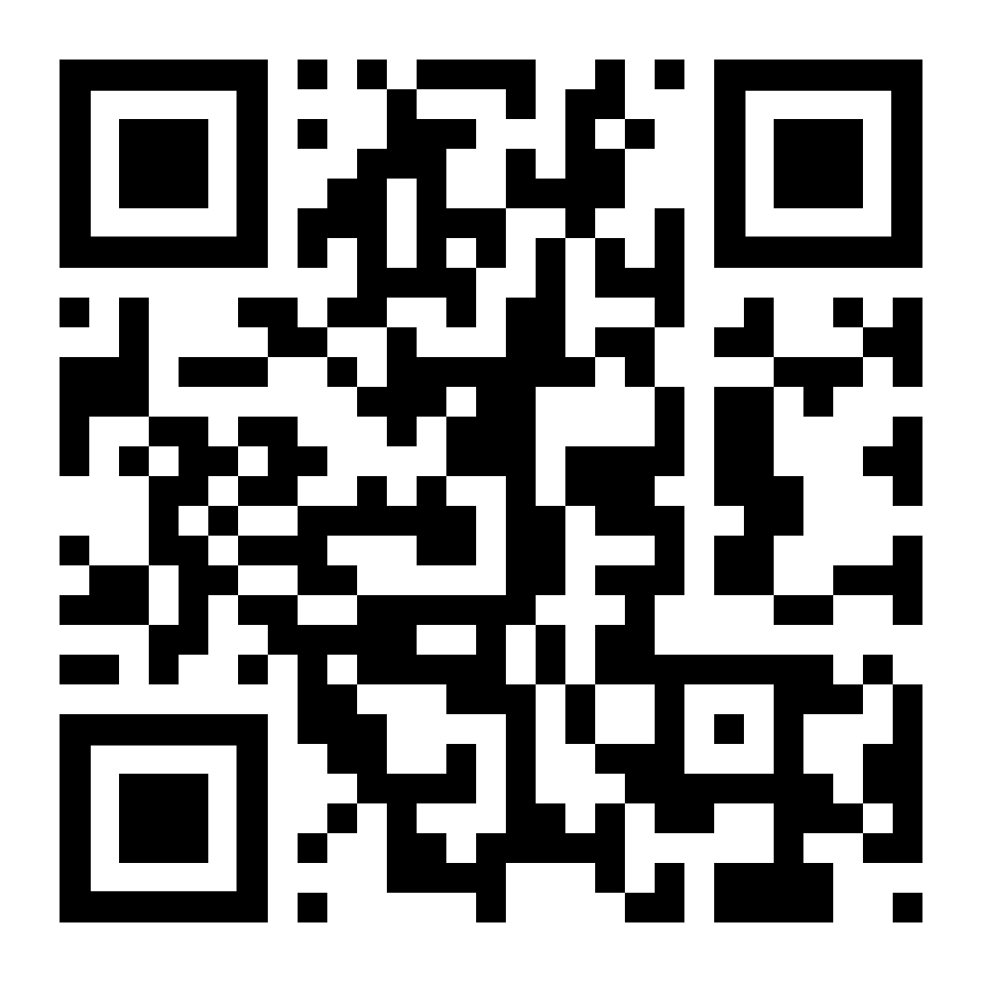
Want to talk it through?
Happy to jump on a free 30-minute tech strategy session and talk about AI, your CRM, security, or whatever's relevant to you.
Notes:
If any of this was useful and you want to talk through where your agency's actually at, happy to jump on a quick chat, thirty minutes, completely free, no pressure. We can talk through whatever's relevant to you, whether it's AI, your CRM, security, whatever it ends up being. Scan the QR code here and it'll land you straight on the booking page. And if you'd just like a copy of the slides, everyone who registered will get them sent through afterwards, so you don't need to write anything down. Thanks so much for the time, really appreciate it.

