Slide 1
Talent Acquisition Insights
Emma Mirrington
June 2026
Notes:
Over the last few months, we've spoken to 137 Talent Acquisition leaders to understand how they're working with agencies today and where they see those relationships evolving.
What emerged wasn't a picture of agencies becoming less relevant, but a market where expectations are rising and clients are becoming much more selective. I want to share some things that stood out.

Slide 2
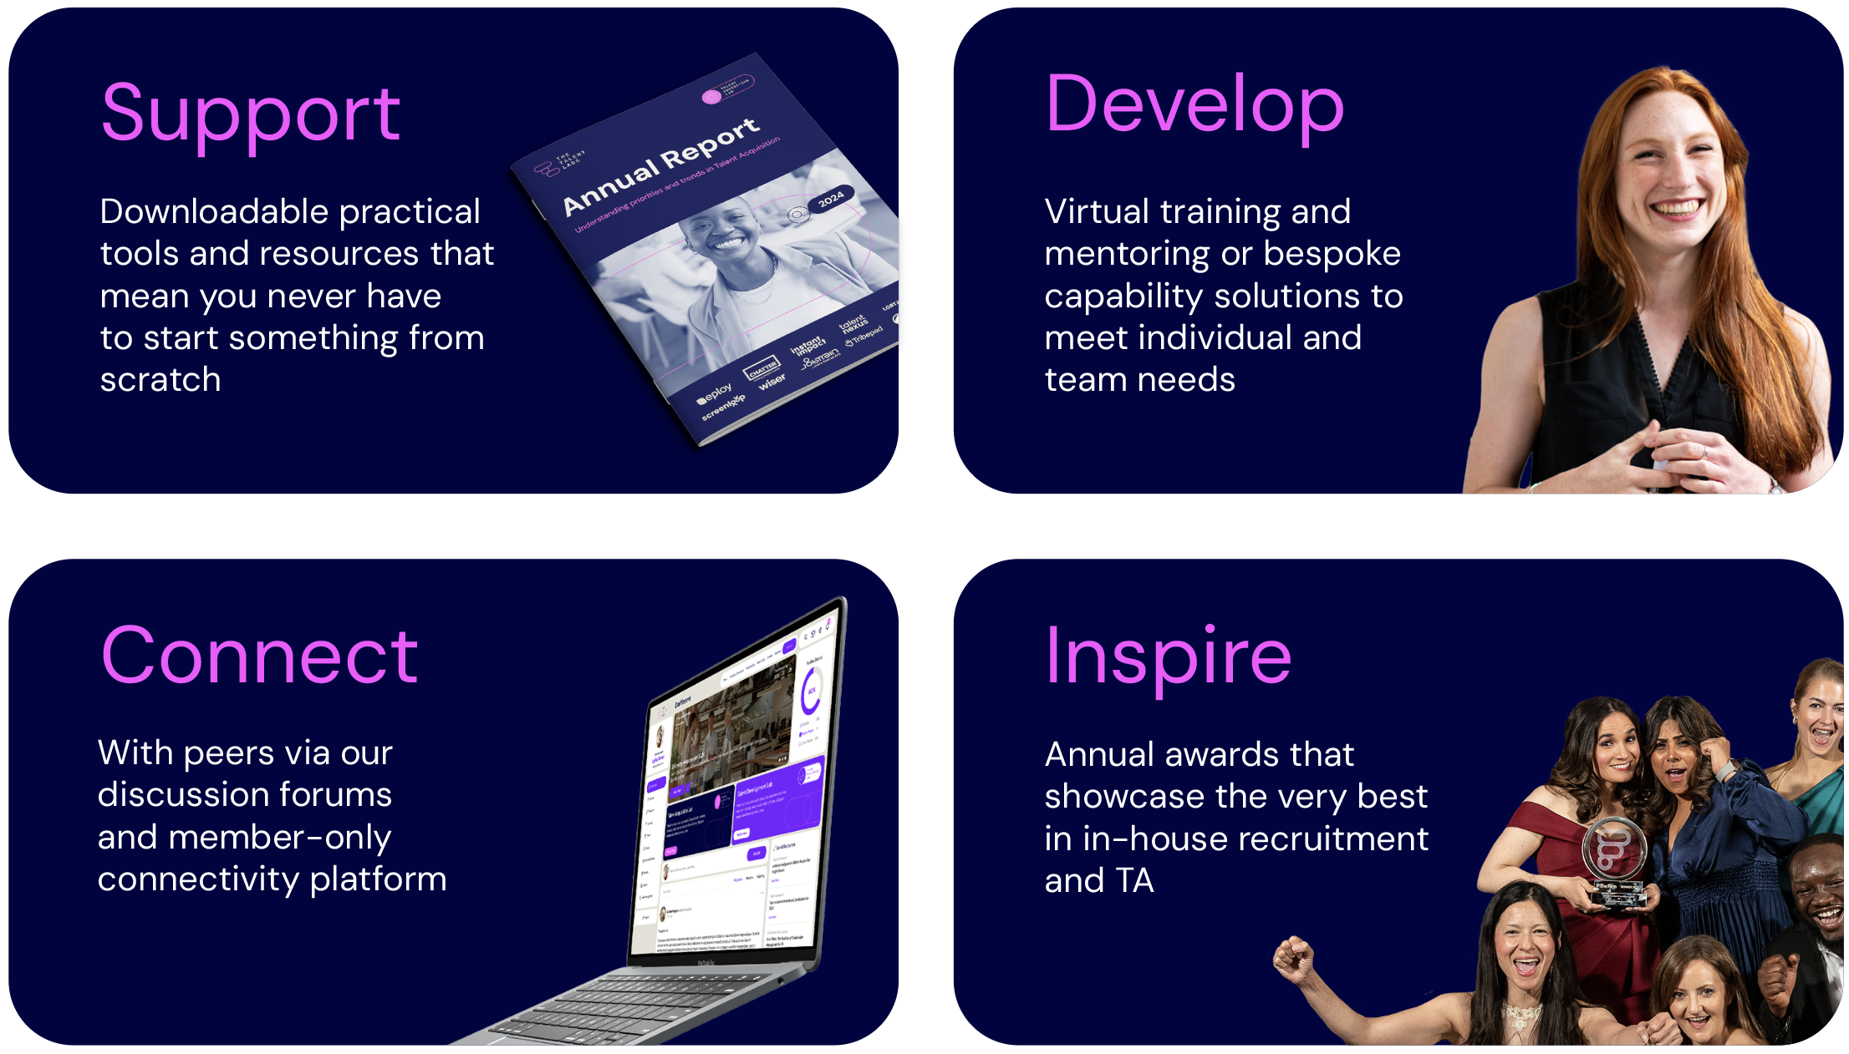
About The Talent Labs
We are:
Run by talent professionals, for talent professionals
The go-to place for all your practical, tactical and strategic talent support
A thriving community that reflects the full spectrum of talent
Independent, trusted experts with our finger on the pulse of the talent market
Notes:
1 mins
10.06-

Slide 3
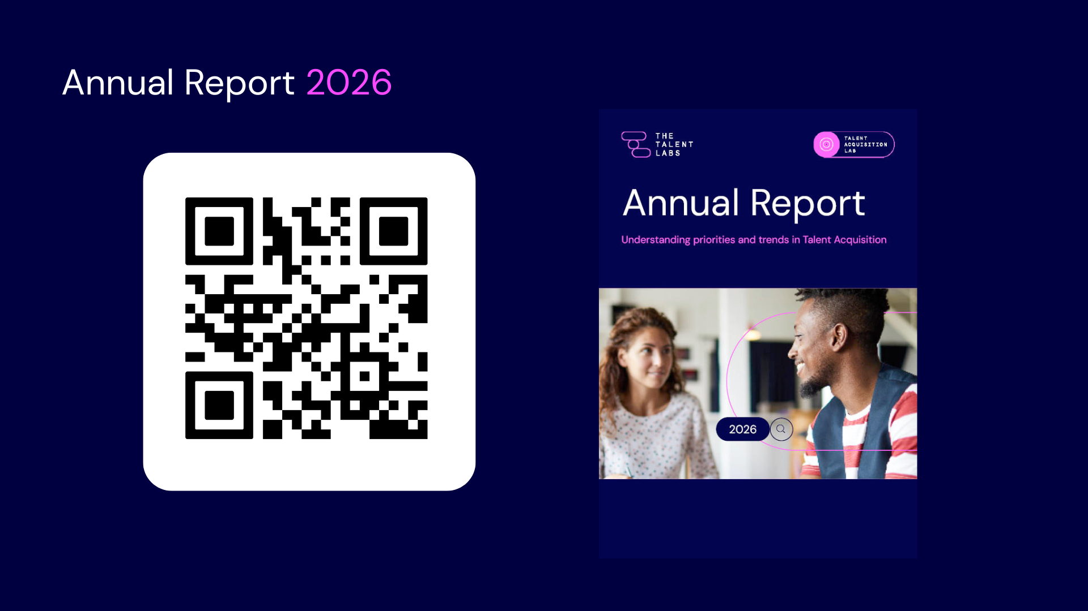
Notes:
11th year of the survey – do have some copies on the stand if you want to come and find us

Slide 4
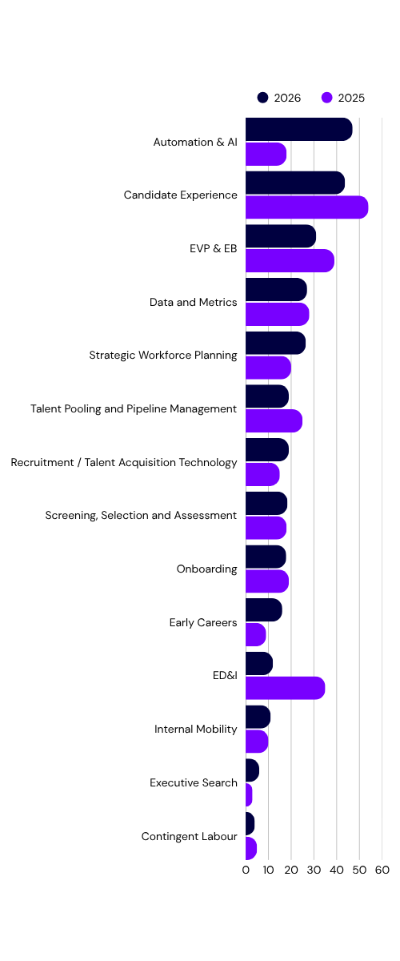
Top Priorities for TA in 2026
Notes:
Top priorities for TA in 2025:
Candidate Experience (53.51%)
EVP / EB (39.46%)
ED&I (35.14%)
Data & Metrics (28.11%)
Automation & AI take the top spot
• 41% of TA teams now prioritise Automation & AI (up from 18%).
Candidate experience still matters but ownership is slipping
• Only 19% have dedicated CX resource (down from 25%).
• 61% now use candidate or hiring-manager surveys (up from 46%).
ED&I drops out of the top three
• ED&I as a priority falls from 35% to under 10%.
• Yet ED&I practice continues to mature: 47% are Disability Confident (35% last year).
• ED&I deprioritised, not devalued

Slide 5
Agencies Still Matter.
3%
There's plenty of discussion about AI, increased inhouse TA capability, direct sourcing and shrinking reliance on agencies.
But one finding really stood out.
of TA leaders believe agencies add limited value.
Agencies aren't disappearing
Expectations are changing
Notes:
There's a lot of noise around AI, direct sourcing and stronger in-house teams reducing the need for agencies.
But one finding really jumped out at me. Only 3% of TA leaders felt agencies provide limited value.
So this isn't a conversation about whether agencies matter. It's about where and how they create the most value. Agencies aren't disappearing, but clients are expecting more and are changing the way they engage with you.

Slide 6
Clients Are Becoming More Selective.
TA teams are stronger than they've ever been and are increasingly deliberate about when and where they engage agencies.
One statistic really illustrates the shift.
42%
of organisations have reduced agency usage over the last two years.
Fewer suppliers
Deeper partnerships
Notes:
Internal TA capability has matured significantly over the last few years.
Organisations are increasingly deliberate about where they spend agency budget.
Almost half of respondents told us they've reduced agency usage.
But this isn't anti-agency. What we're seeing is a move from lots of suppliers to a few trusted partners.
Relationships are becoming deeper and more strategic.

Slide 7
Expertise Wins.
#1
The strongest agencies aren't replacing internal TA teams.
They're complementing them.
When we asked where agencies add the most value, one area came out on top.
Access to hard-to-reach talent (28%)
Complex hiring creates opportunity
Expertise commands value
Notes:
Agencies aren't competing against internal TA teams. The best partnerships are complementary.
Internal teams handle the majority of hiring and bring in external expertise where they need additional capability.
The number one area where agencies add value was access to hard-to-reach talent.
That's encouraging because complexity creates opportunity. Clients are prepared to invest where agencies can do something they can't easily replicate themselves.

Slide 8
The Bar
Is Higher.
27%
Overall sentiment towards agencies was very positive.
But TA leaders were clear about where agencies could create even greater value.
want agencies to better understand their culture and EVP.
Know the business
Culture & EVP
Not just the vacancy
Notes:
The sentiment towards agencies was overwhelmingly positive.
But respondents were clear about where agencies could create even more value.
The biggest opportunity wasn't around fees. It was around understanding culture, EVP and business context.
Great agencies don't just understand the role. They understand the organisation and can represent it authentically to candidates. Increasingly, clients want partners, not suppliers.

Slide 9



What Should Agency Leaders Focus On.
?
The data suggests three areas will increasingly separate average agencies from exceptional ones.
Become more specialist
Bring insight, not just candidates
Understand your clients better
Market intelligence, salary benchmarks, and talent trends add genuine value beyond the shortlist.
Great agencies operate as a seamless extension of the client – understanding culture, EVP and business context that a job description doesn’t always show.
Depth of expertise in specific sectors and roles is what TA leaders value most.
Notes:
Looking across all of the data, three themes consistently emerged.
First, become more specialist. Complexity creates demand.
Second, bring insight, not just candidates. Salary intelligence, market trends and competitor knowledge are increasingly valuable.
Third, understand your clients better than ever before. The best agencies operate almost as an extension of the internal TA team. They understand the culture, the EVP and the context behind the vacancy. That's where I think exceptional agencies will continue to differentiate themselves.
"The future isn't fewer agencies. It's fewer relationships, higher expectations, and bigger opportunities for those agencies that can genuinely operate as trusted talent partners."

Slide 10
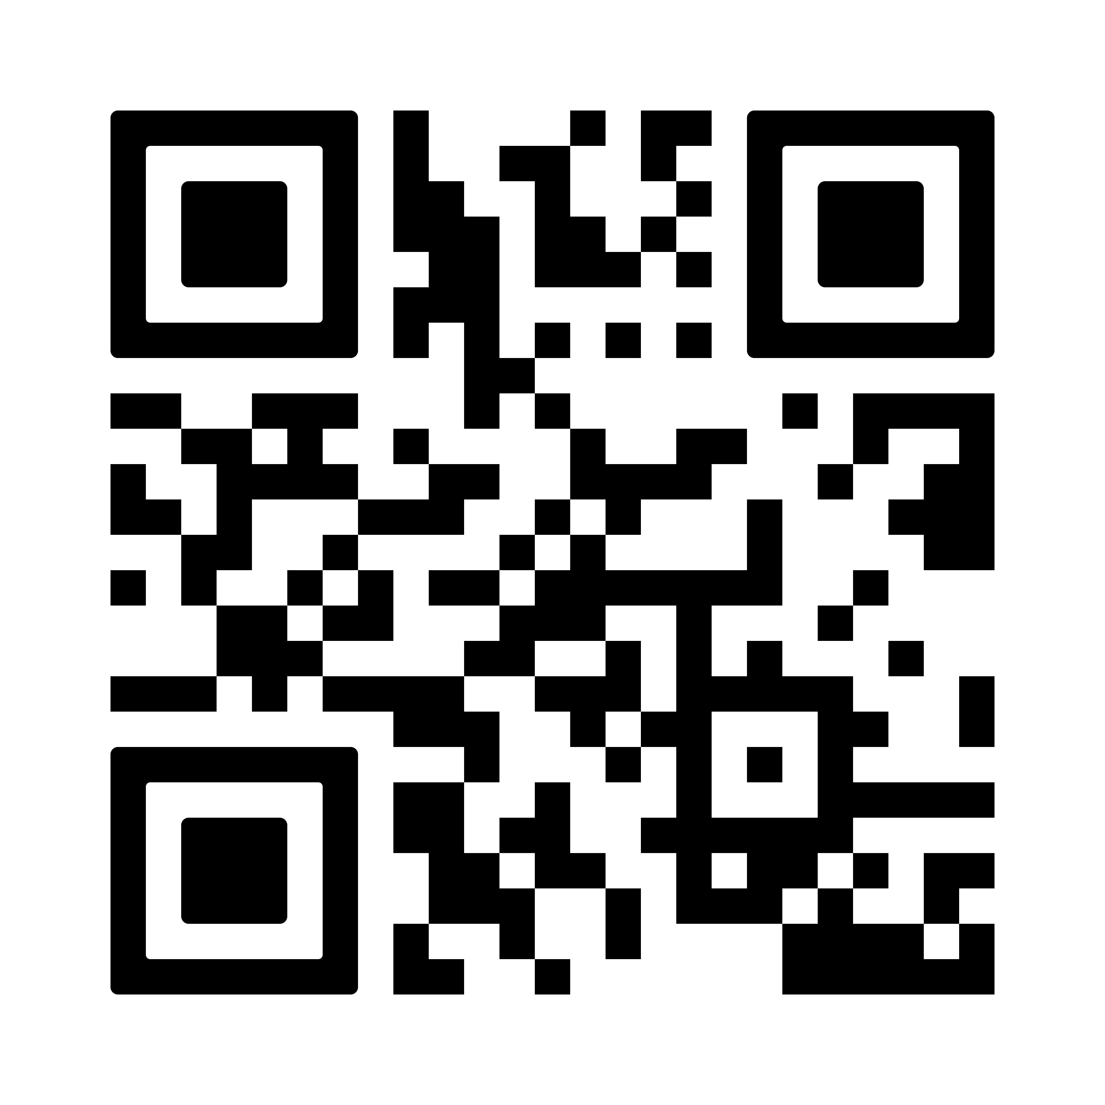
Thank you!
emma@thetalentlabs.com

