Slide 1



Accelerate Your Marketing
Marketing For Growth
Sponsored by:

Slide 2
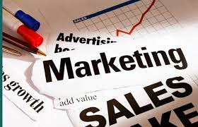
2 /5
Aligning Sales And Marketing
Marketing is brand-to-person; Sales is person-to-person — and Sales is a marketing channel.
Push prospects further down the purchase funnel before Sales steps in.

Slide 3

3 /5
Marketing As Operations
Every organisation is now a media company. Attention is the most precious resource — everything has expanded except time.
Your digital presence is not separate from your offering — it IS part of your value.

Slide 4
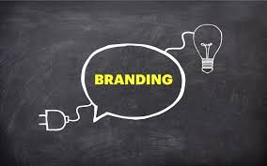
4 /5
Marketing As Brand
Brand is the glue that holds everything together — brand distinctiveness is your greatest asset.
Brands reduce purchase risk and make buying decisions easier, building loyalty through consistency.

Slide 5
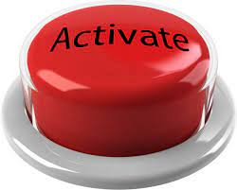
5 /5
Marketing As Sales Activation
Balance long-term brand building with short-term sales activation to drive sustained growth.
Success is the result of doing everything else right — brand and activation must work together.

Slide 6
For more articles and videos about what we have covered today, please visit:
www.stickymarketing.com
Grant Leboff | grantleboff@stickymarketing.com | T: +44 203 308 2951
©2026 Grant Leboff. All Rights Reserved

