Slide 1
TheTalent Reset
How External Forces are Reshaping Talent and the Leadership Decisions that Follow
Matt Burney
Senior Strategic Advisor, Indeed

Slide 2
The UK labour market remains fragile, but isn’t crashing

Slide 3
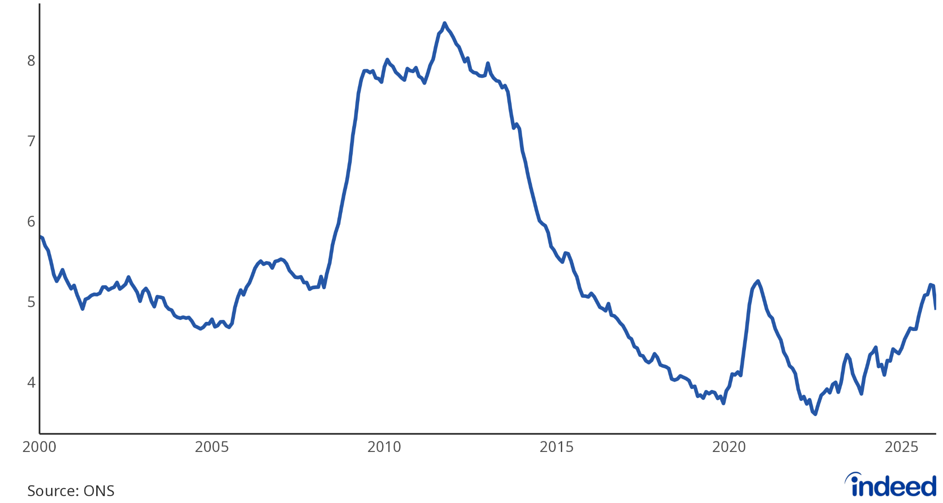
Surprise dip in unemployment isn’t all it seems
Unemployment rate (%), aged 16+, to Feb 2026
Notes:
Inactive, students

Slide 4
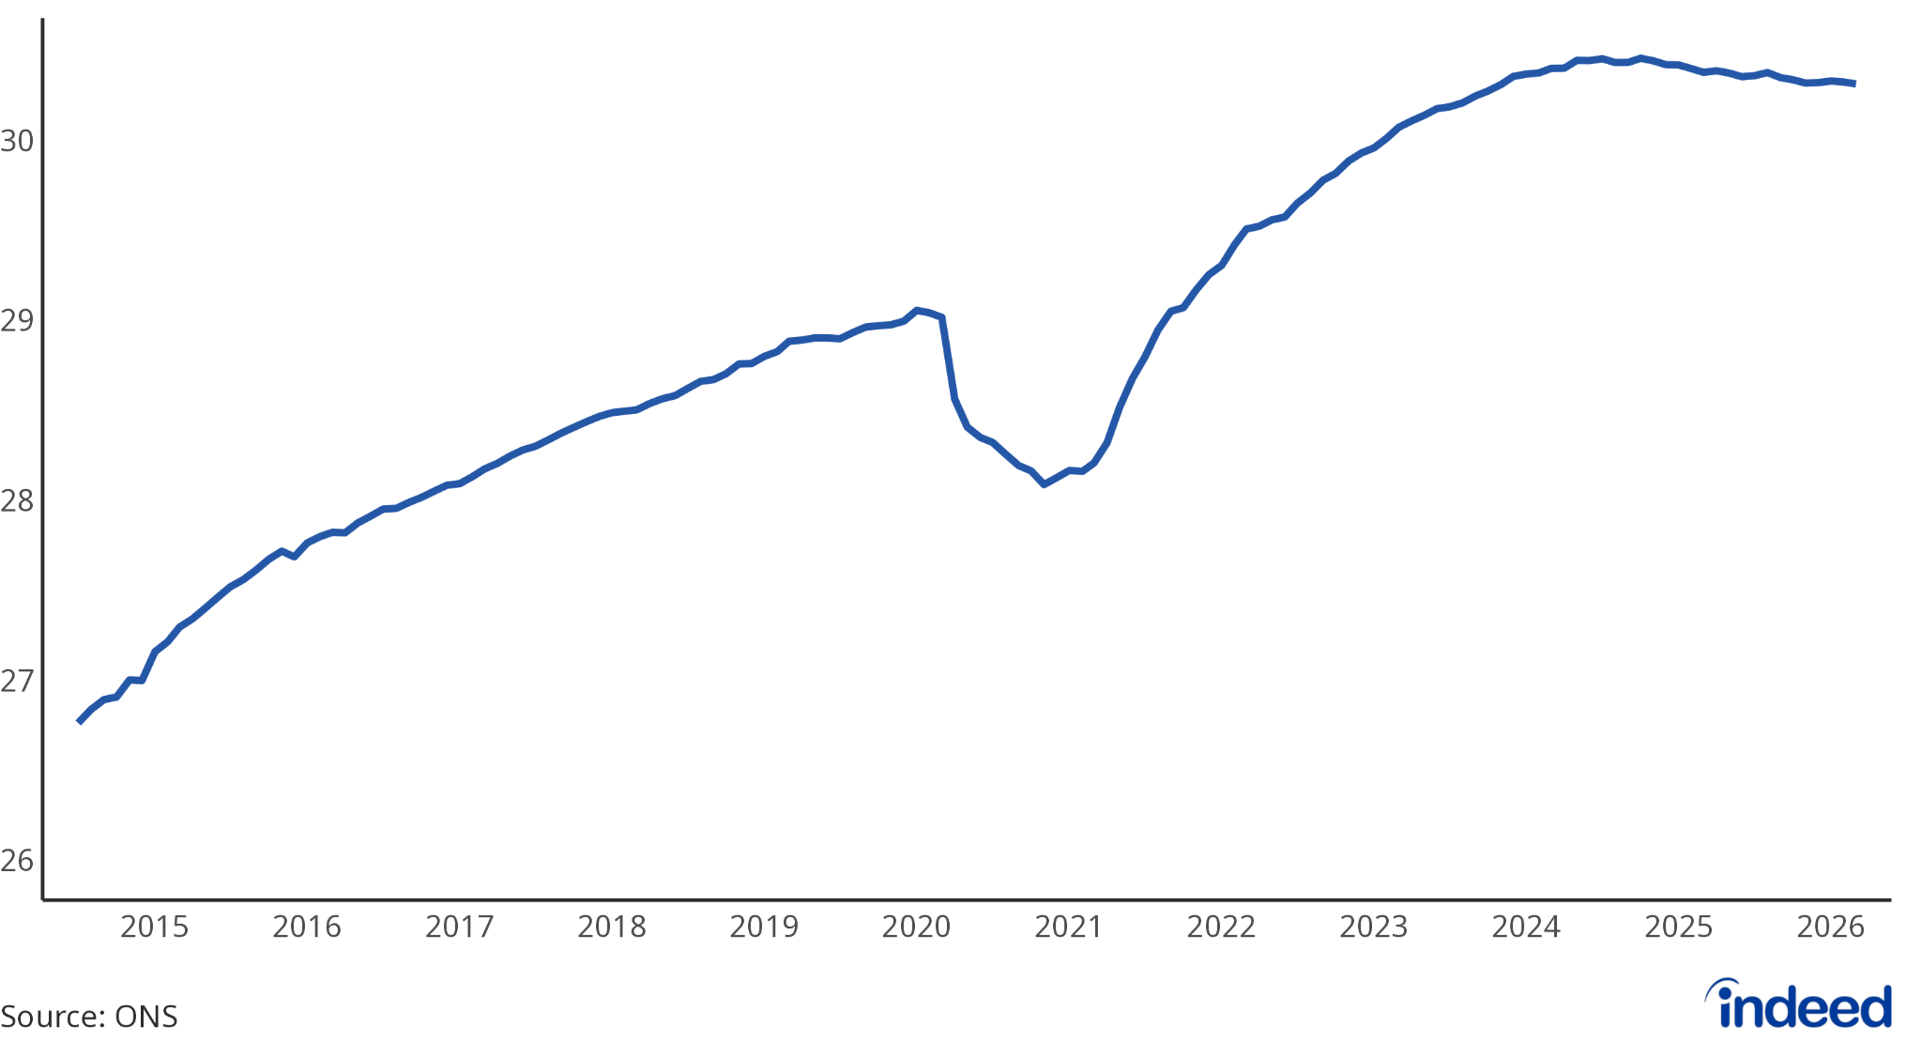
Payrolled employment is broadly stable
Payrolled employees, millions, seasonally adjusted, to Mar 2026

Slide 5
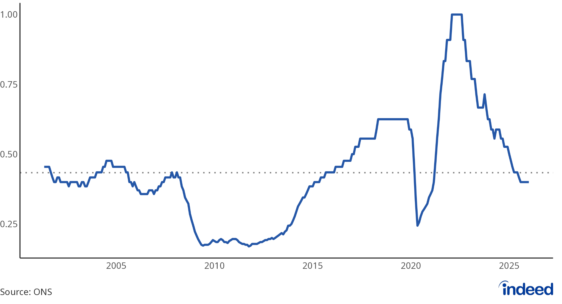
The labour market is slightly looser than its long-run average
Ratio of vacancies to unemployed, to Feb 2026

Slide 6
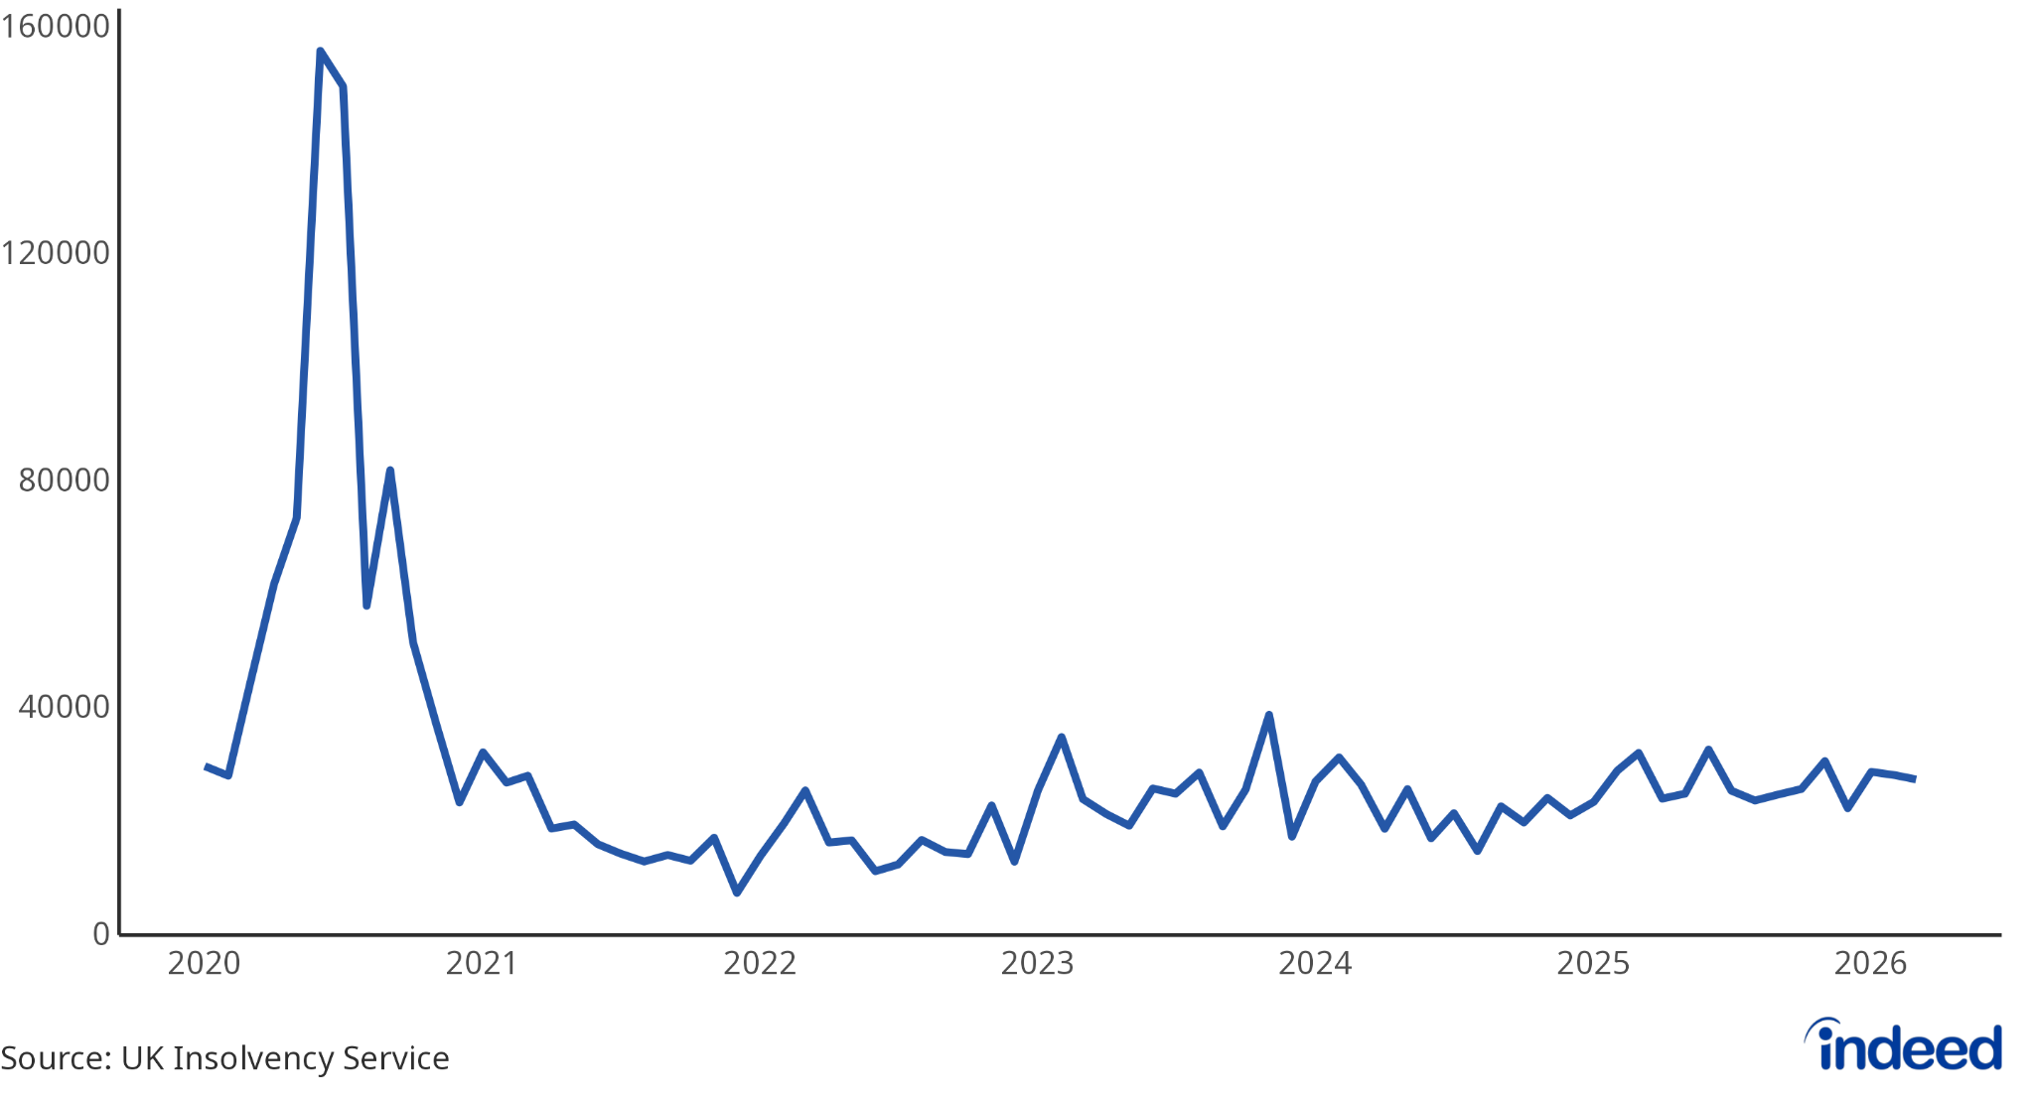
Redundancy notifications remain modest
Potential redundancies notified to government, to Mar 2026

Slide 7
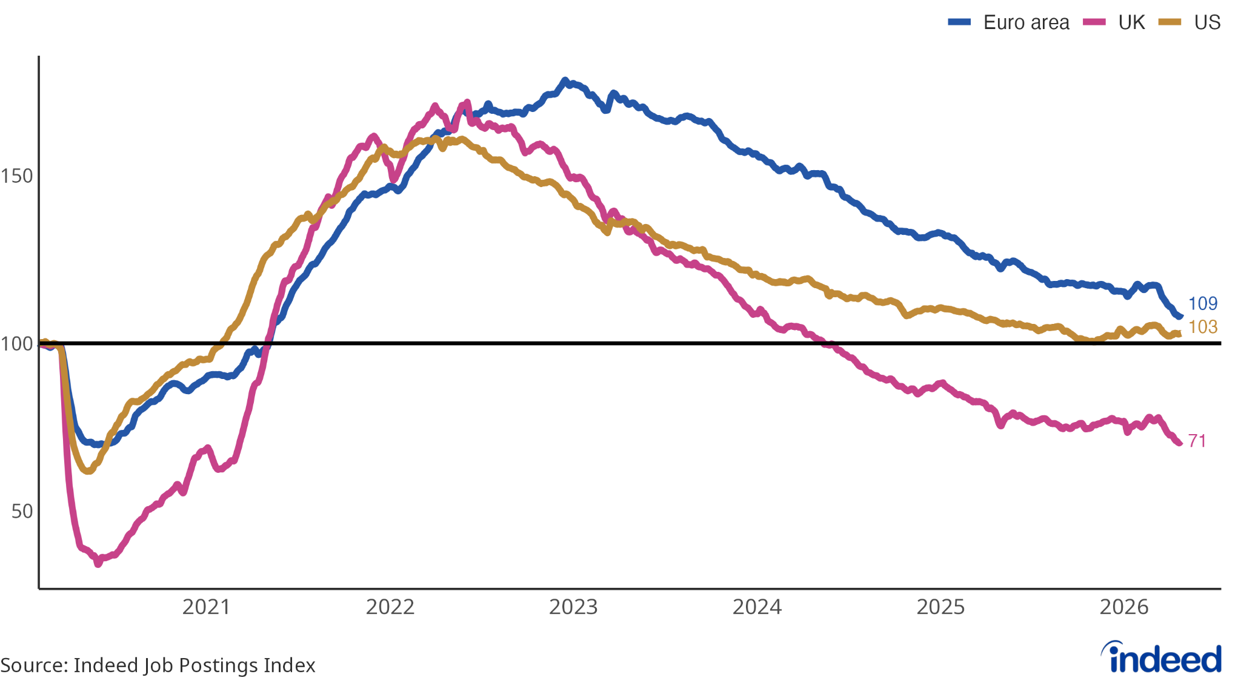
UK job postings have continued to soften
Indeed Job Postings Index, 1 Feb 2020 = 100, seasonally adjusted, to 24 Apr 2026

Slide 8
The System is Under Pressure

Slide 9

The Hiring Paradox
58%
49%
Employers saying that hiring became more difficult in the past 3 years
Jobseekers saying that finding a job became more difficult in the past 3 years
Source: Indeed Survey with YouGov, Total N=9671 jobseekers and 5666 employers
Notes:
Employers say they cannot find people with the right skills. Job seekers say they are competing with too many others. Both are right.

Slide 10
The Four Forces Reshaping Talent

Slide 11
01
Skills Are Replacing Proxies as the Currency of Talent

Slide 12

Job Seekers already expect to be judged on experience, not potential
63%
32%
32%
believe the key employer question will ask is about on-the-job experience
want employers to encourage applicants without a degree
want hiring teams to assess skills over proxies
Source: Indeed Survey with YouGov, Total N=7162 job seekers and 4411 employers
Notes:
Our research shows that globally, most job seekers expect the hiring conversation to focus first on experience.
63% believe the most common question employers will ask is whether they have relevant on-the-job experience.
At the same time, around a third of job seekers are asking employers to encourage applications from people without a degree, and to train hiring teams to assess skills over proxies like years of experience.
What this tells us is not that job seekers want lower standards, but that they want clearer and fairer signals.
And when signals stay vague, another shortcut often fills the gap

Slide 13
When companies dropped their degree requirements, those employees stayed in their roles 20% longer than their counterparts.
Source: Sigelman, M., Fuller, J., Martin, A. (February 2024). Skills-Based Hiring: The Long Road from Pronouncements to Practice. Published by Burning Glass Institute
Notes:
One of the strongest indicators that this approach works is what happens after hiring.
A Harvard Business School study found that when companies dropped degree requirements, those employees stayed in their roles 20% longer than their college-educated counterparts.
That doesn’t mean degrees don’t matter. It means that clearer signals about skills and expectations lead to better matches and more sustainable outcomes.
A good example of how this works in practice comes from healthcare.

Slide 14
02
AI Accelerates the Obsolescence of Skills

Slide 15


Evaluation in two dimensions
Problem-solving ability
Necessity of physical presence
How does GenAI transform a certain skill?

Slide 16

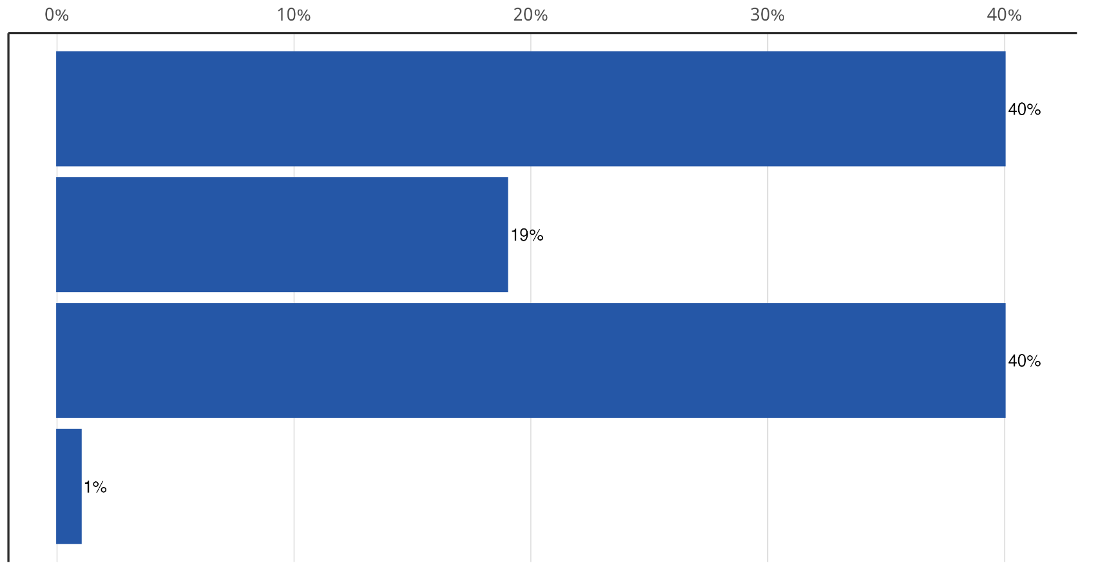
Distribution of ~2,900 skills across GenAI Skill Transformation Index levels.
Derived from GPT-4.1 and Claude Sonnet 4 evaluations.
Most skills are transformed to some extent
Minimal
Assisted
Hybrid
Full
Transformation level
Source: Indeed

Slide 17
03
Learning Becomes Economic Infrastructure

Slide 18
82%
But only 67% of jobseekers think that they will need upskilling in the same timeframe
of employers anticipate that their employees' skills will need to fundamentally evolve in the next 3-5 years
Source: Indeed and YouGov survey, n=6837 jobseekers and 2481 employers

Slide 19
04
Work is Multigenerational by Default

Slide 20
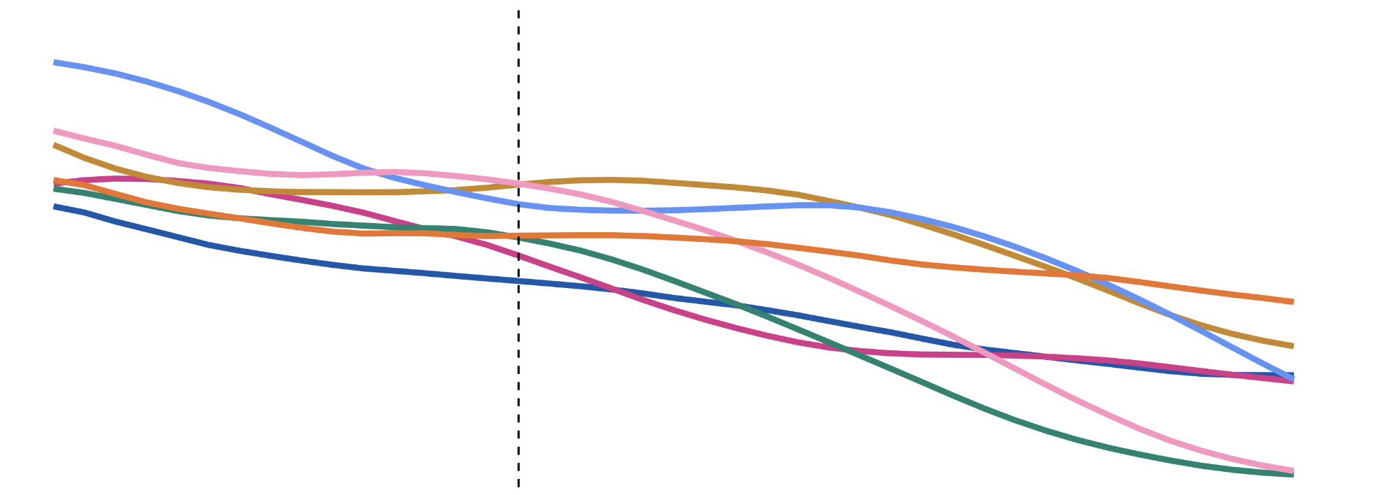
Working-age populations are set to decline across Europe
Population aged 15-64 as a share of total (%), 2010-2050
France
Ireland
Poland
United Kingdom
70
Germany
Italy
Spain
65
60
55
2010
2020
2030
2040
2050
Source: World Bank
Notes:
Demographic trends imply a declining pool of workers in coming years
Aging populations across Europe mean the share of working age people is going to fall significantly as a proportion of the population

Slide 21
Millennials are seen as most ambitious
44% of employers identified them this way
Gen X is seen as most competent
50% of employers cited them for this trait
Generational stereotypes are leading to barriers in employment
Gen Z are considered to be overly reliant on technology
54% of employers agreed with this view
Boomers are considered to be most risk-averse
28% of employers expressed this belief
Source: Indeed Survey with YouGov 2024, n=5600

Slide 22
The Leadership Gap

Slide 23

Can leadership lead through uncertainty?
40% of employers state that "workforce and leadership skills” is the single most critical skills gap in their organization today
Notes:
By now, a clear pattern emerges. It’s not the external forces that are the problem—it’s how organizations respond. One key insight runs across everything: the biggest capability risk often isn’t in the workforce, but in leadership’s ability to lead through uncertainty. Transformation stalls when leaders cling to familiar signals, wait for certainty that will never come, or delegate change instead of modeling it themselves. Initiatives like skill-based hiring, AI adoption, and building learning cultures don’t fail because people resist—they stall because leadership hesitates.

Slide 24
01
Do we continue hiring for familiarity or for future capability?
02
Do we use AI to reinforce old processes or to redesign them responsibly?
03
Do we treat learning as a benefit or as essential infrastructure?
Notes:
The forces reshaping talent are already at work.
Artificial intelligence enables scale.
Skills provide direction.
Learning sustains capability.
What ultimately determines success is leadership judgment. Not reacting faster, but deciding better.

