Slide 1
Finding growth now
Neil Carberry, 29th June 2026

Slide 2
Why do people buy?
“A large proportion of our positive activities depend on spontaneous optimism rather than on a mathematical expectation...
Most, probably, of our decisions to do something positive... can only be taken as a result of animal spirits – of a spontaneous urge to action rather than inaction...”

Slide 3
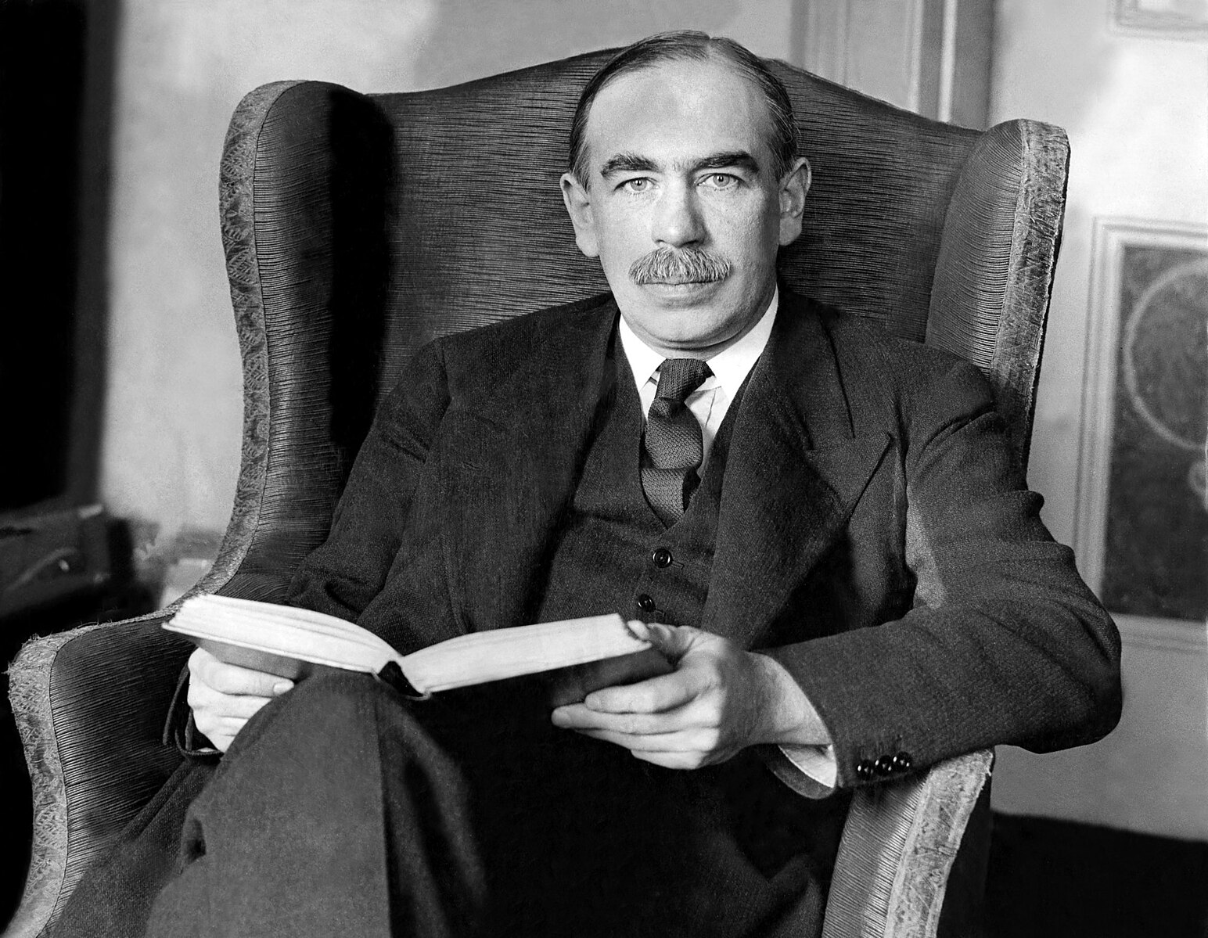
Why do people buy?
“A large proportion of our positive activities depend on spontaneous optimism rather than on a mathematical expectation...
Most, probably, of our decisions to do something positive... can only be taken as a result of animal spirits – of a spontaneous urge to action rather than inaction...”

Slide 4
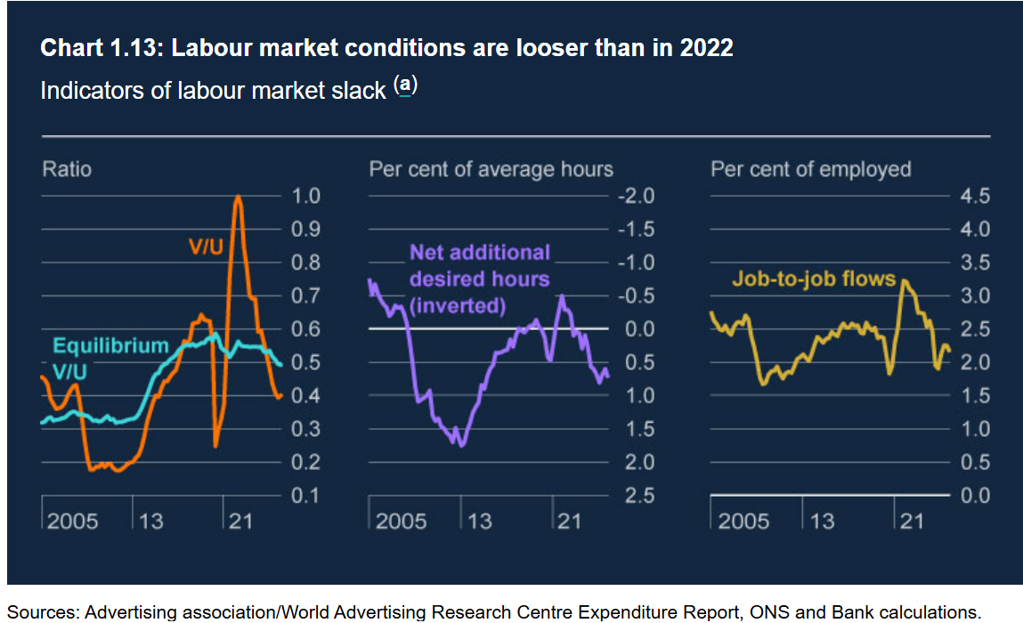
UK economy – June 2026
May 2026 CPIH inflation was at 3% - 0% change on previous month
v
Unemployment rate up to 4.9% in Feb– Apr 2026.
v
UK GDP 0.7% in in the three months to April (Feb - Apr 2026)
v
Bank of England – April 2026 Monetary Policy Report
As of June, BoE interested rates are held at 3.75% -this is likely to rise as the year progresses
BoE reports vacancy levels have stabilised since mid‑2025, but unemployment is rising and is expected to reach 5.3% by mid‑2026.
Employment growth is expected to remain muted.
Higher unemployment and lower job vacancies meant the unemployment ratio (V/U) remains below equilibrium.
April 2026 BoE and June ONS data
Notes:
Next GDP on 12 June 2025
Next CPI on 18 June

Slide 5
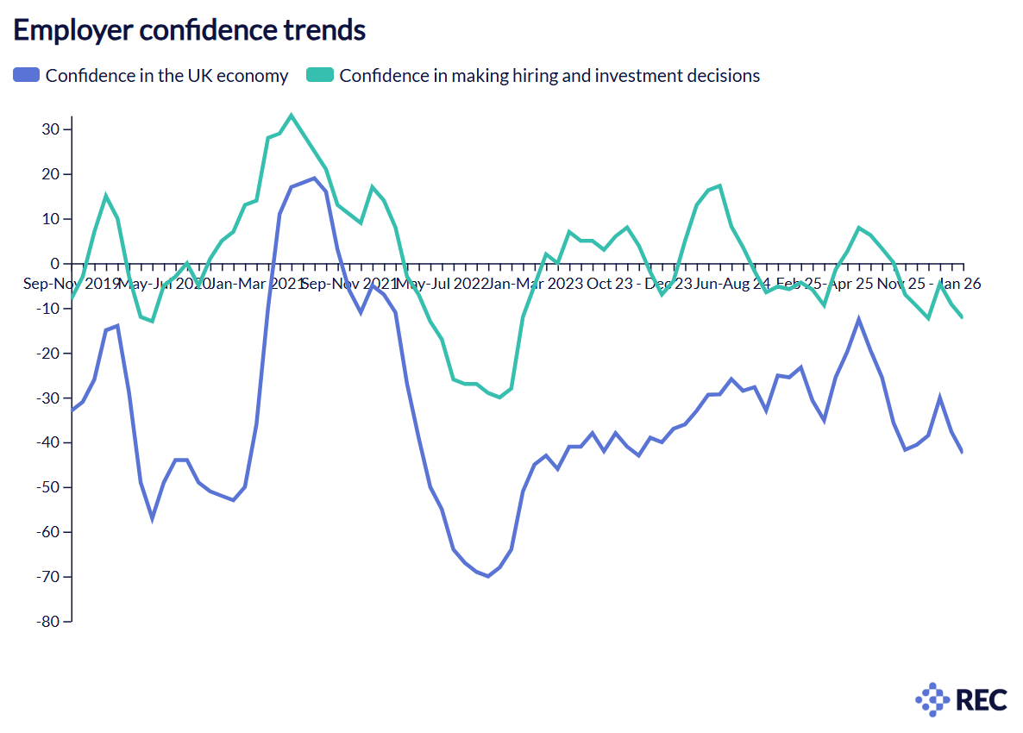
Jobs Outlook: confidences in the UK economy and hiring
drops.
REC Jobs Outlook May 2026

Slide 6
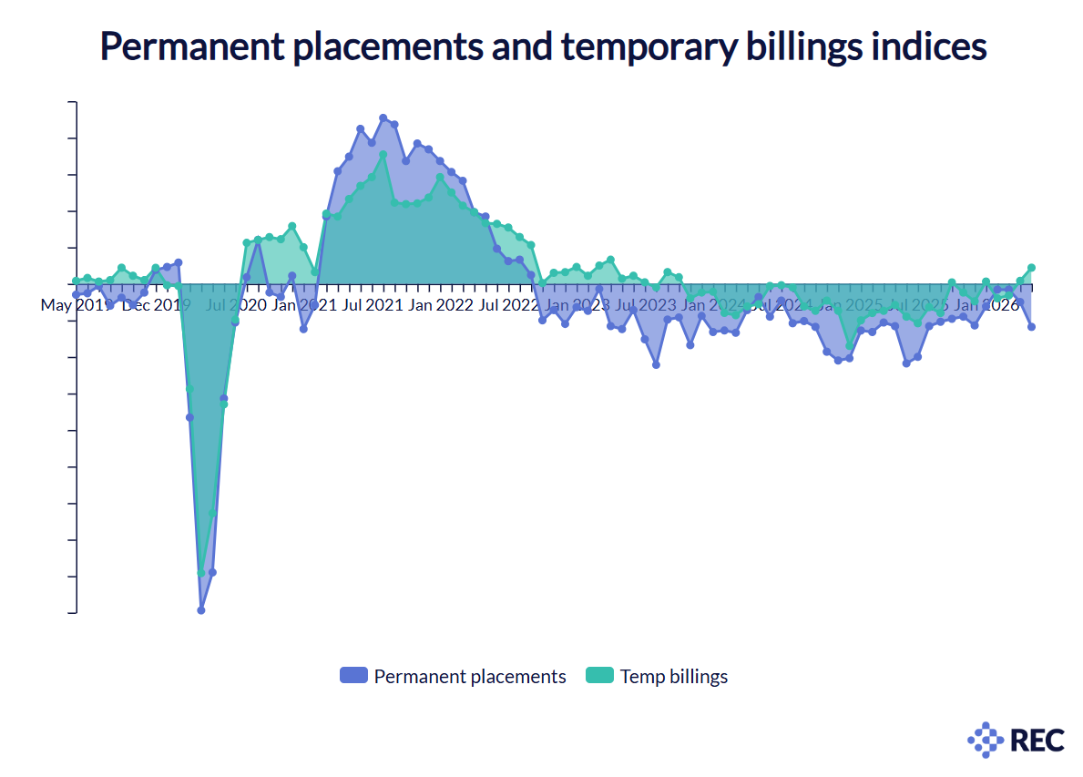
Report on Jobs: shift to flex
Temp billings increased at the fastest rate in over three years, but permeant placements fell
Overall demand for staff fell at the quickest pace for the three months up to May.
This is due to a steeper reduction in permanent vacancies. This was the weakest reduction in short-term vacancies in the last 22 months.
REC/KPMG Report on Jobs June 2026

Slide 7
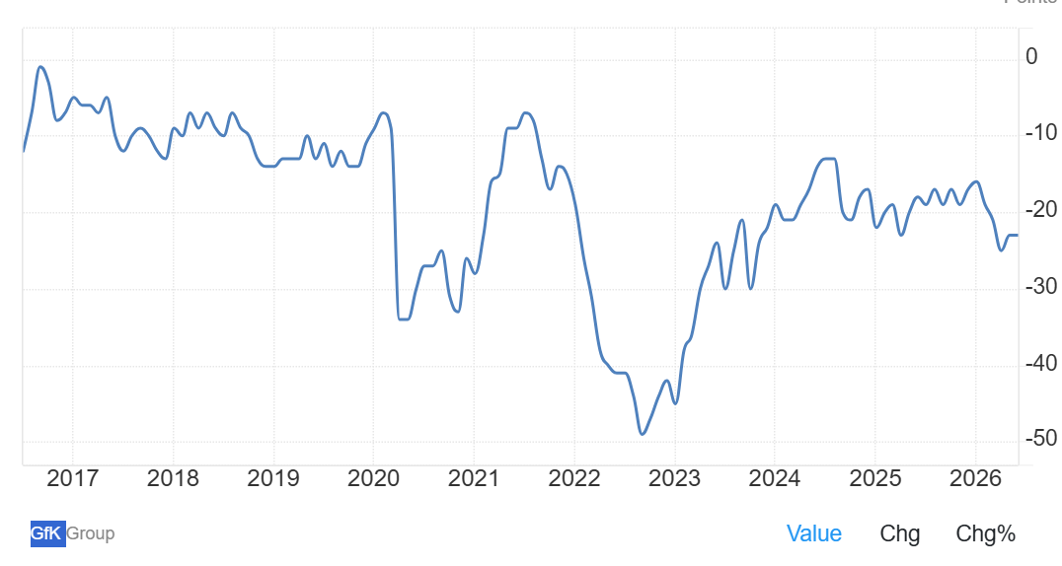
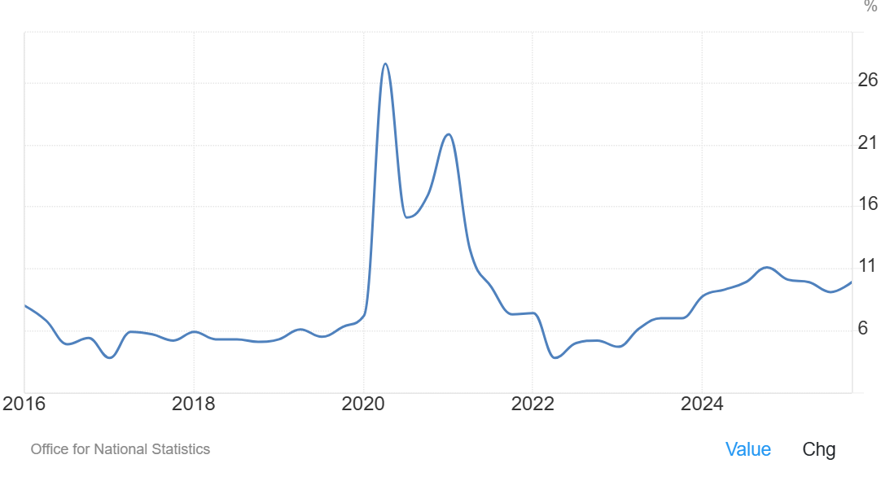
Households are the same…
Lower than trend consumer confidence is seeing higher than trend savings. What if we could get that money working?

Slide 8
The leadership challenge of our age
“Tomorrow is being made today. Leaders need to become change agents.”

Slide 9
Everything changes….
AI rewrites the labour-capital split. But how?
Demographic changes exacerbate workforce planning challenges.
Workforce expectations misaligned.
Unpredictable geopolitics.

Slide 10
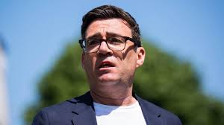
What’s next?
Keir Starmer resigned a week ago – it is already becoming clear that Andy Burnham is the lead candidate, with others pulling out.
Another candidate is not impossible, with the nomination process running from 9th -16th July, but at the moment a coronation seems likely.
Even if there is a contest, Burnham will be the heavy favourite.

Slide 11
So what do we know?
Burnham is an interventionist and a devolver by instinct. We should expect things like the industrial strategy, including energy and infrastructure thinking, to come back centre stage. He will likely challenge “Treasury orthodoxy” on how to do things – his appointment of a Chancellor will be key.
This move could be good or bad – the question is not whether the state has a role to play – but what is chooses to do. He will be hidebound by the same political challenges as Starmer but is widely viewed as a better communicator. He will need to do what Starmer has failed to – articulate an overall vision of what he is trying to build.
While his instincts are no less “big state” than Starmer – and possibly more so – he is well known for being able to work well with businesses. The REC has always enjoyed a good relationship with him, and found his thinking to be pragmatic. In some sectors – like utilities – more public control is likely, in others there is a chance to open up new conversations. New appointments at key departments – like health – open up opportunities to reset relationships for REC.
The path ahead on regulation for our industry is unclear, but a volte-face on the agenda in the Employment Rights Act is unlikely, especially if this change brings Angela Rayner back to Government. It does, however, offer us the chance to bring different ways to deliver that agenda to the table, and to increase practicality.
The path ahead on tax and spend is unclear – but the fiscal picture remains challenging.
Agenda

Slide 12
Why am I telling you all this?

Slide 13
Why is this a moment of opportunity
The way we do talent has failed:
Too short-term,
Too price focussed
Too transactional
Too much professional service offered for free.
Good firms will break this cycle. Every business in the country will rewrite its operating model, and they don’t know how to do it.
Find them – and have the skills to connect.

Slide 14
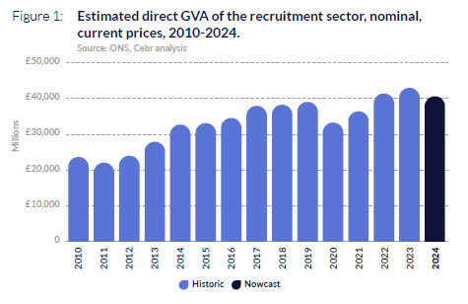
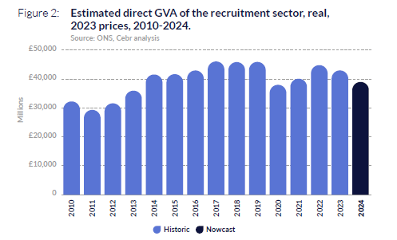
Get off the treadmill!

Slide 15
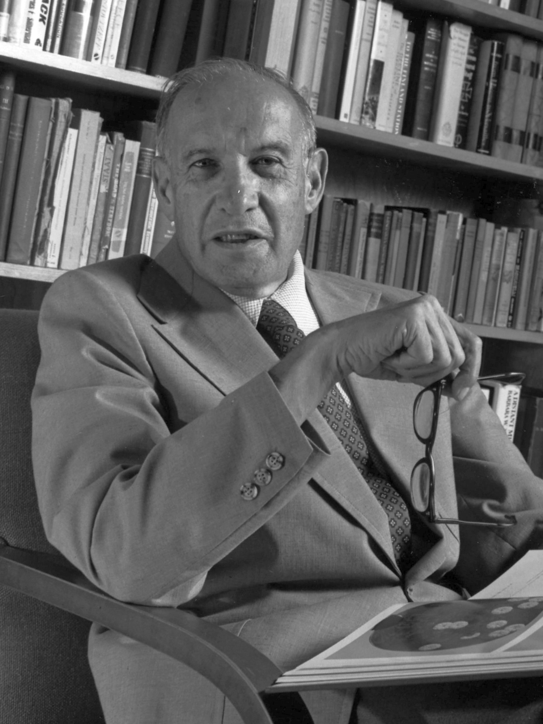
The leadership challenge of our age
Tomorrow is being made today. Leaders need to become change agents.

Slide 16

Thank you!

