Slide 1


Cally Beaton

Slide 2

Notes:
STAND UP STAND OUT
H G WELLS – ‘IF YOU FELL DOWN YESTERDAY, STAND UP TODAY’

Slide 3


Slide 4

Notes:
FAST FORWARD 20 yrs. ITV BOARDROOM.

Slide 5

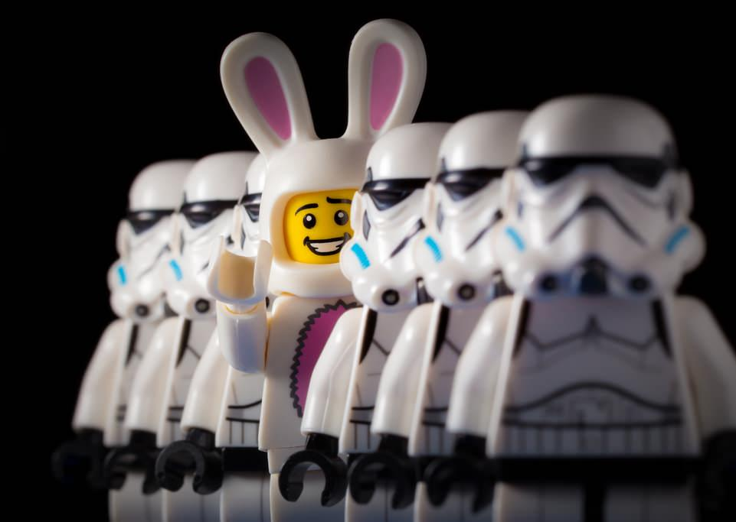
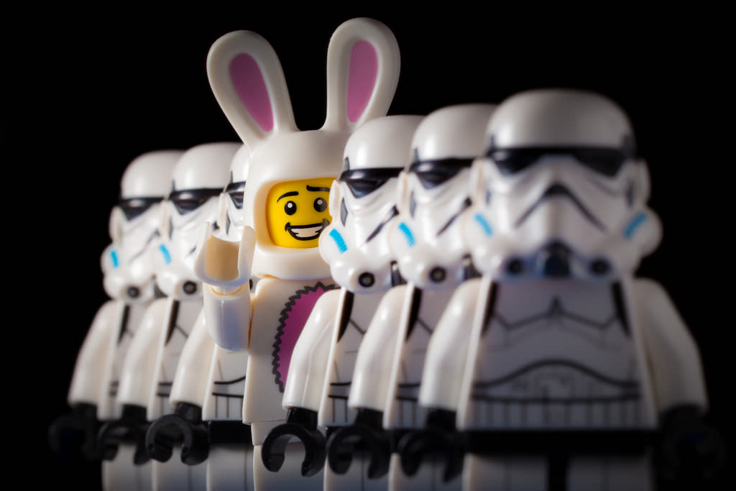
Notes:
IMPOSTOR - DISRUPTOR

Slide 6
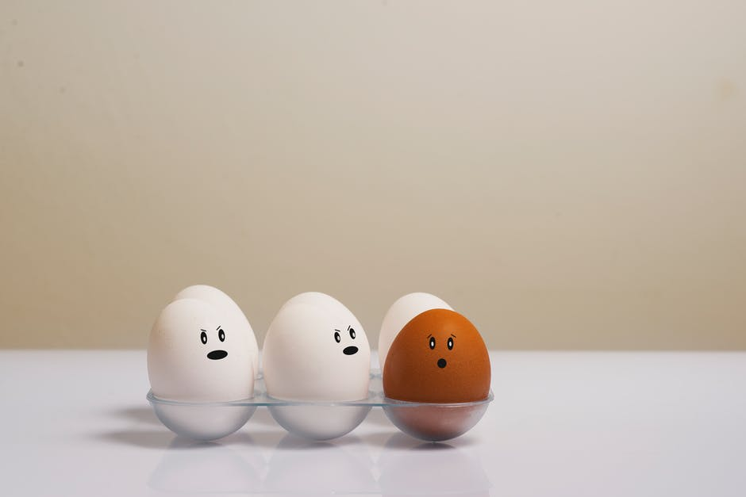
Notes:
SENSES OF SELF

Slide 7

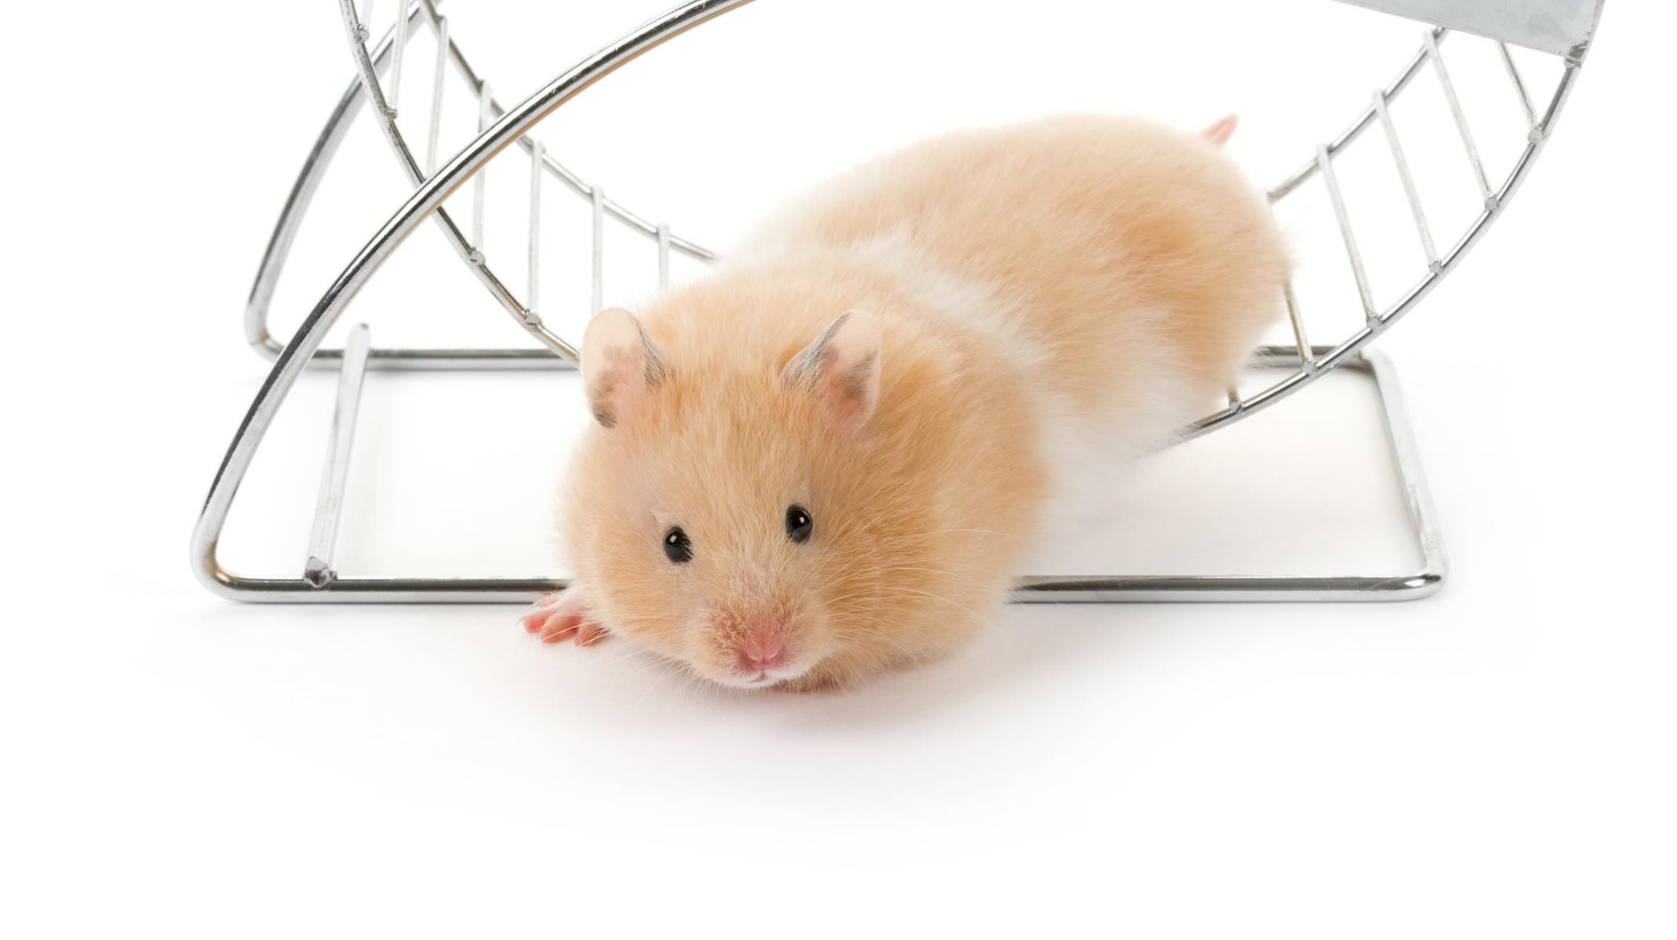

Notes:
IMPOSTER/DISRUPTER
BYSTANDER/UPSTANDER

Slide 8

Notes:
"Quiet isn't always peace and the norms and notions of what 'just is' isn't always 'just is'" - Amanda Gorman, 22, youngest inaugural poet in U.S. history

Slide 9
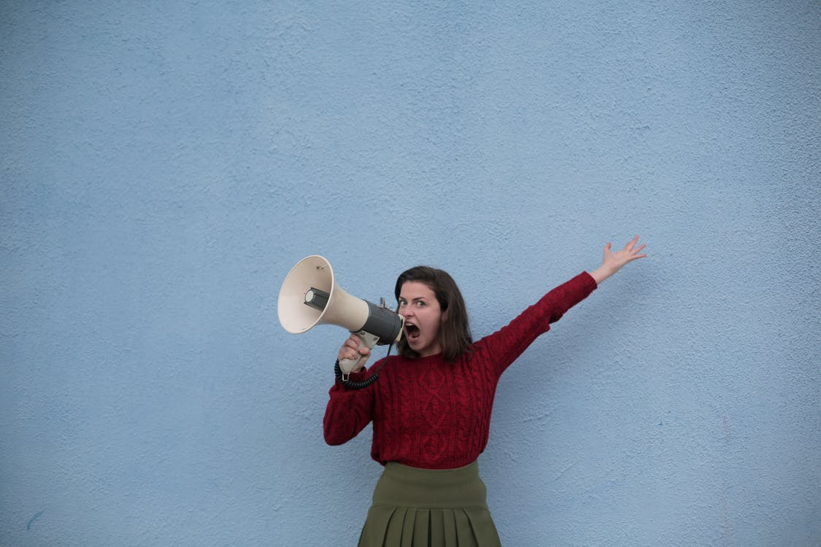

Slide 10
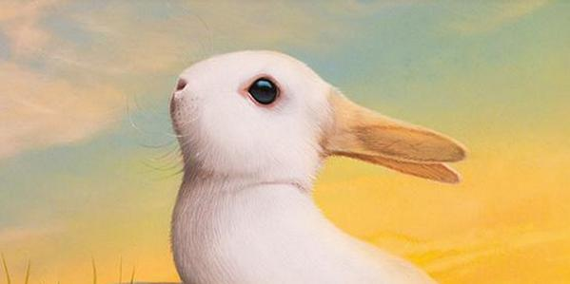

Slide 11
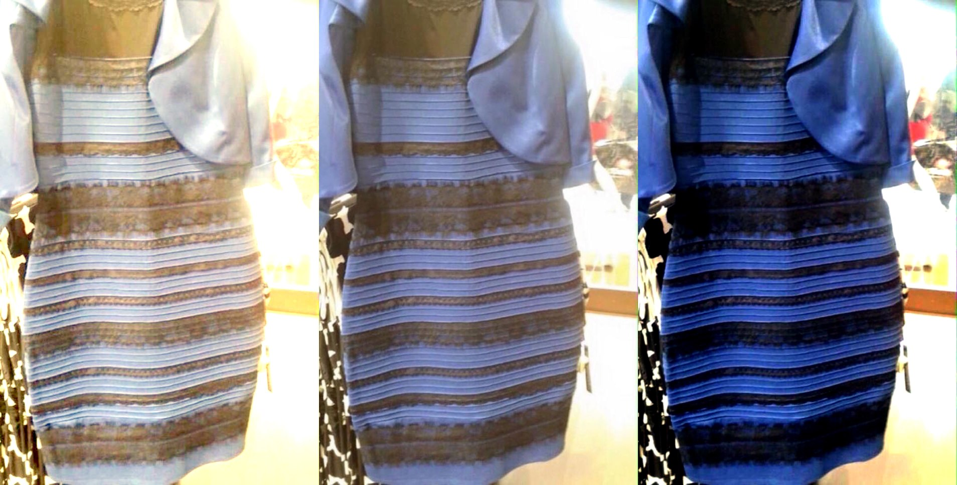

Slide 12
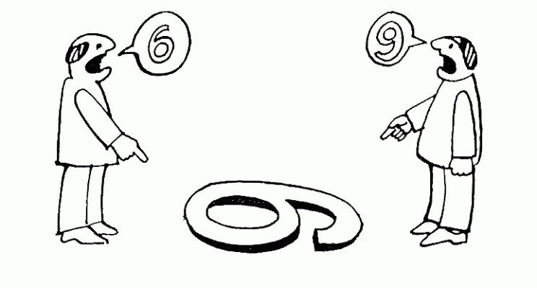

Slide 13

Notes:
DIFFERENCE DOESN’T = LESS

Slide 14

Notes:
WHOLE/SUM OF PARTS
SEEK OUT DIFFERENCE – COMFORTABLE WITH BEING UNCOMFORTABLE

Slide 15

Notes:
EQ OVER IQ.
HOW VS. WHAT

Slide 16
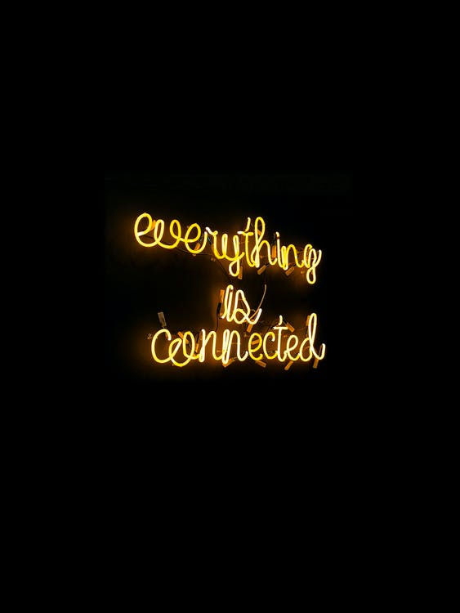
Notes:
WORLDS GETTING SMALLER…
COMMUNICATION AS MEANS TO CONNECTION
HUMAN CONNECTION > COMMERCIAL EXCELLENCE

Slide 17
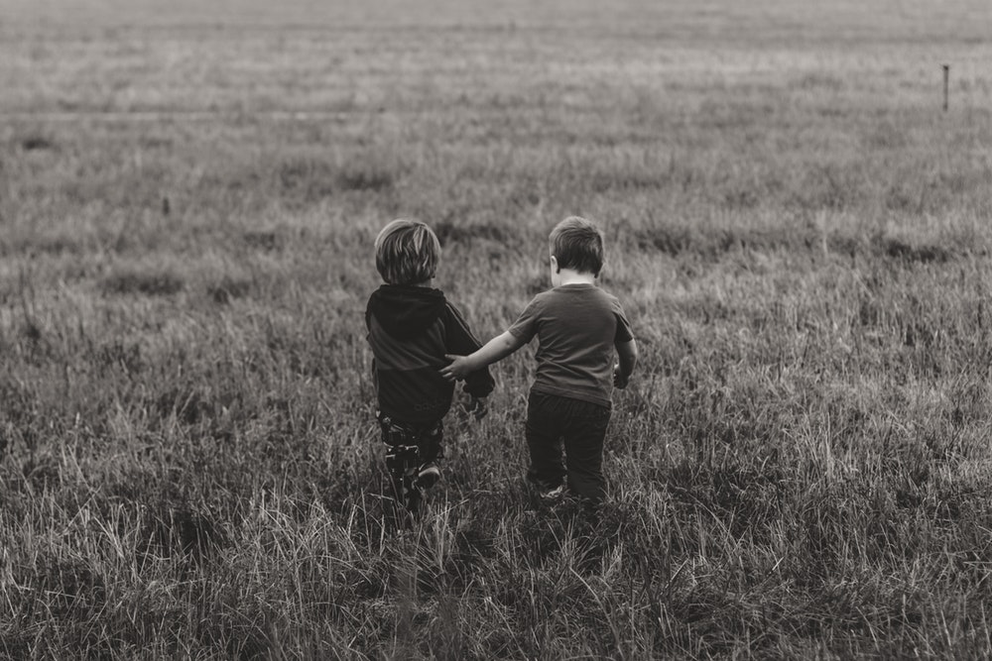
Notes:
PEERS, ATTENDEES, COMPETITION

Slide 18

Notes:
It’s isn’t about the people you know, it’s about the people you don’t know
100 one-off one-hour coaching sessions 2020

Slide 19
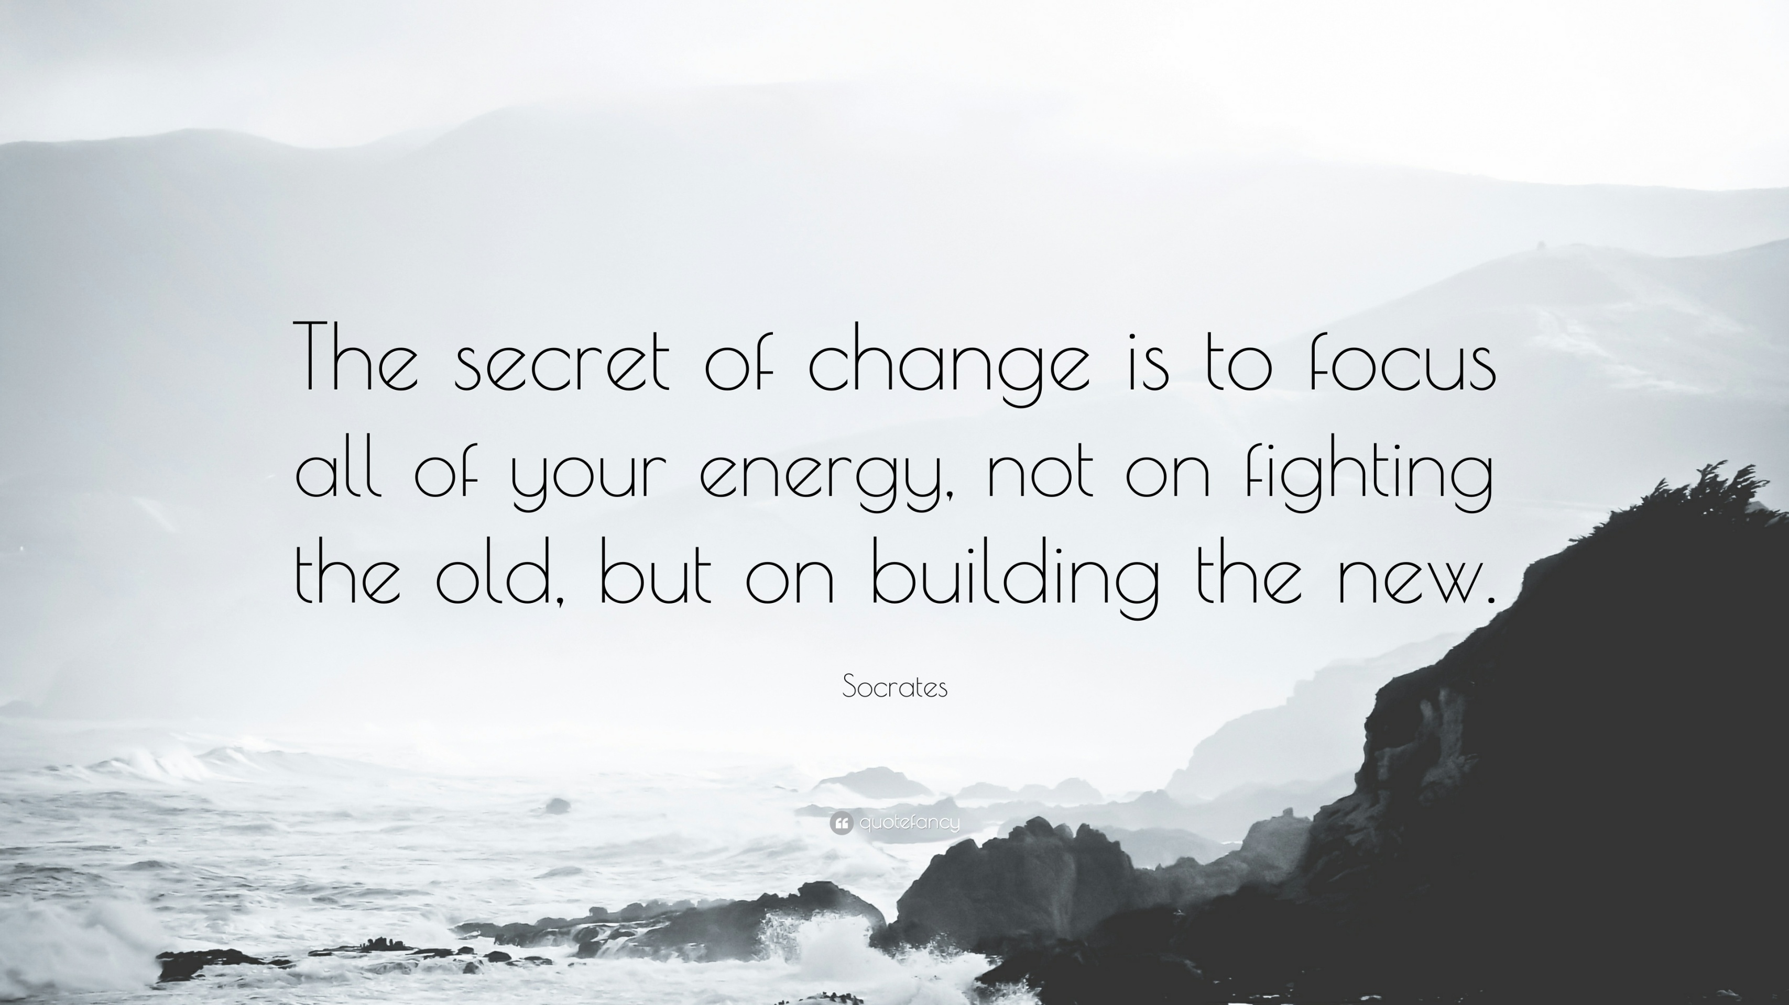

Slide 20


VR experience
Notes:
LIMINALITY – TOWARDS/AWAY FROM
MOTIVATIONAL THEORY

Slide 21
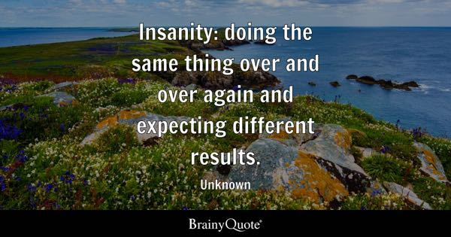
Notes:
IF WHAT YOU’RE DOING’S NOT WORKING, TRY SOMETHING DIFFERENT.

Slide 22
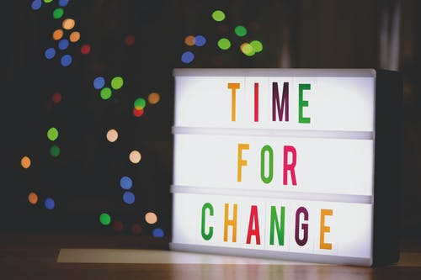

Slide 23

Notes:
FROM BUTTERFLY EFFECT TO RADICAL/UPSIZING

Slide 24


Notes:
12.01AM ON AUG 1, 1981
EARLY 90s/MTV
VIDEO KILLED THE RADIO STAR

Slide 25

Notes:
**MTV CLIP**

Slide 26
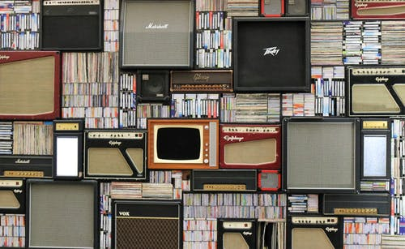
Notes:
NAPSTER, MY SPACE, YOUTUBE

Slide 27
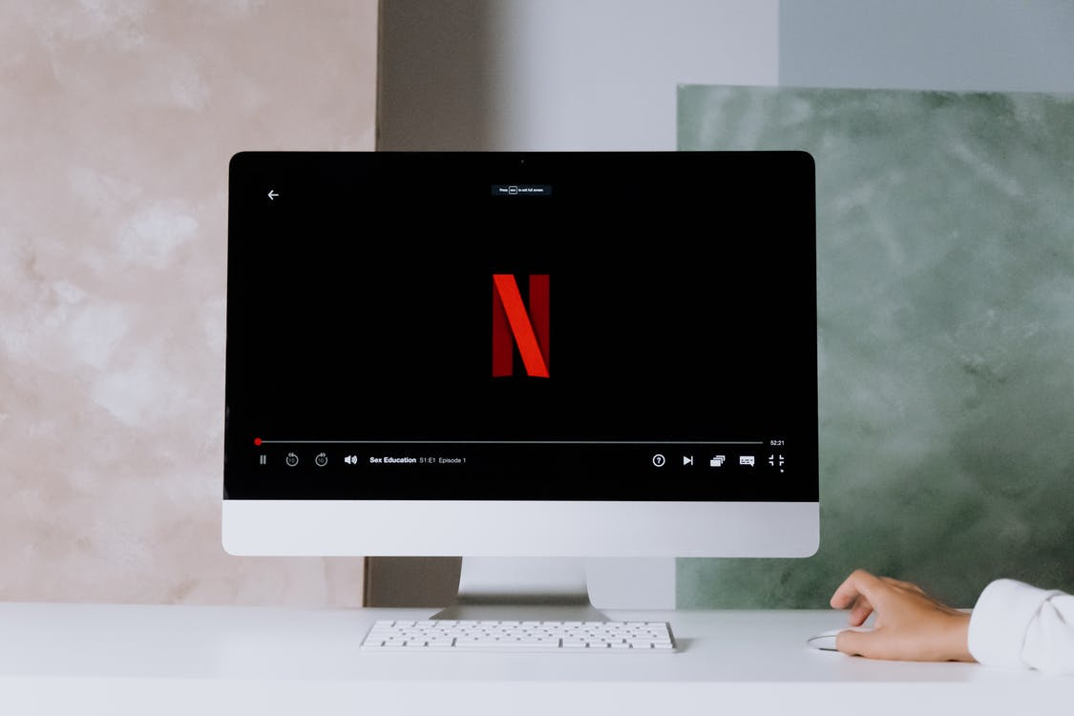
Notes:
DIGITAL CREEP: BROADCAST – VOD
NETFLIX, AMAZON PRIME, APPLE TV, BRITBOX, NOW TV, TWITCH
DISNEY+ LAUNCHED AT START OF LOCKDOWN

Slide 28

Notes:
Tik tok - UGC

Slide 29
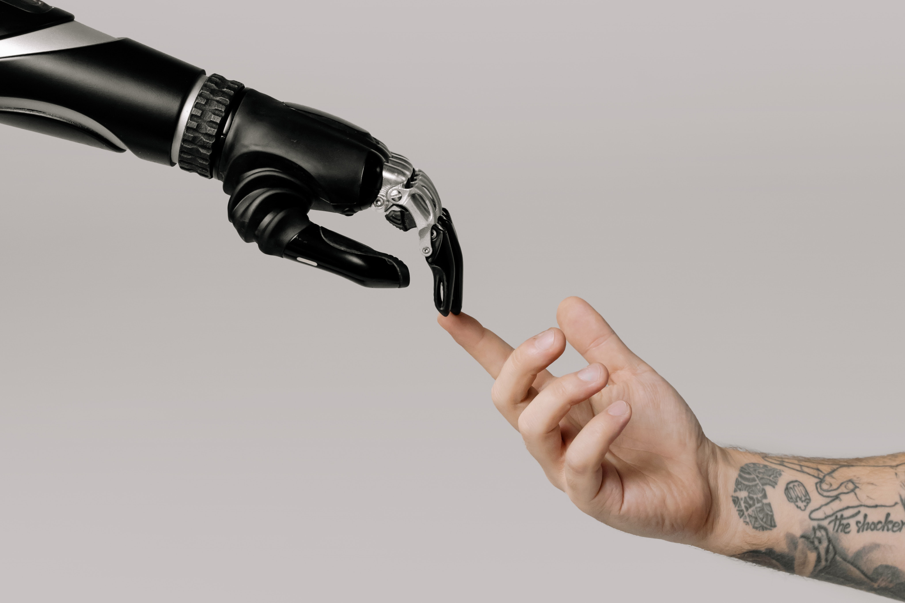
Notes:
AI/CHAT GPT – Cally Siri gag – first didn’t hear the question then said he didn’t understand then said no; might as well have stayed married

Slide 30


Slide 31
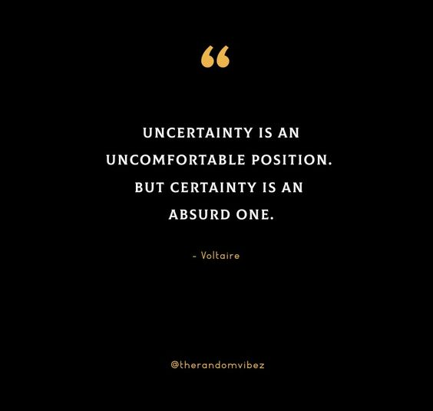
Notes:
DIFFERENCE DOESN’T = WORSE
J STORY

Slide 32


Slide 33
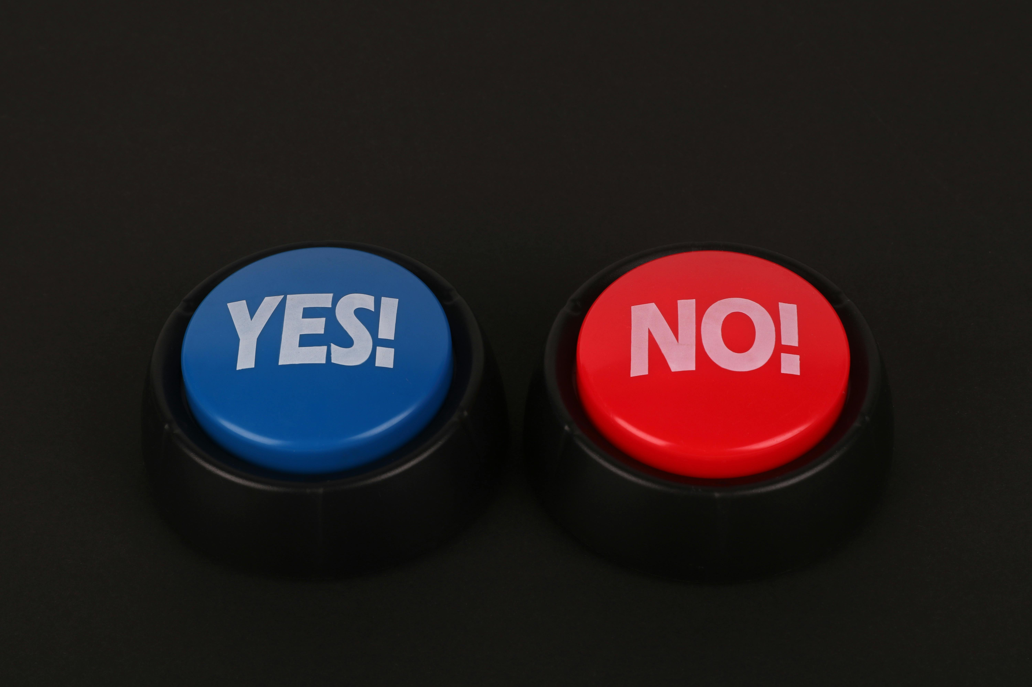
Notes:
YES/NO – WORST OPTION – DO NOTHING. SO DO SOMETHING!

Slide 34
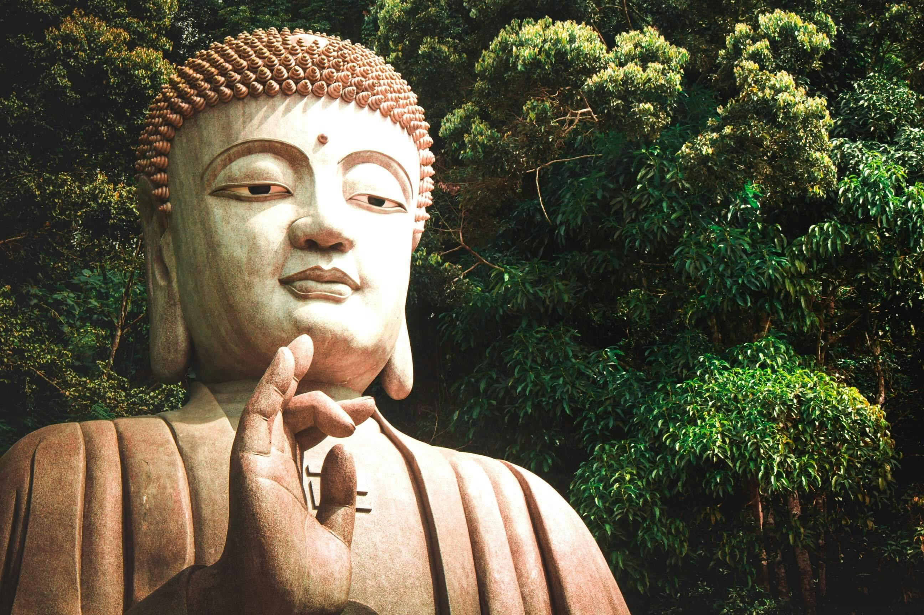
Notes:
Enlarge/diminish

Slide 35
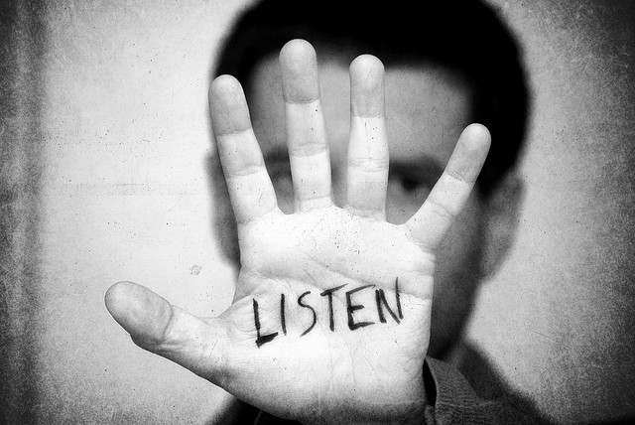
VR experience
Notes:
LISTEN TO LEARN.
SET DIAL TO RECEIVE, AS WELL AS TRANSMIT.
J

Slide 36
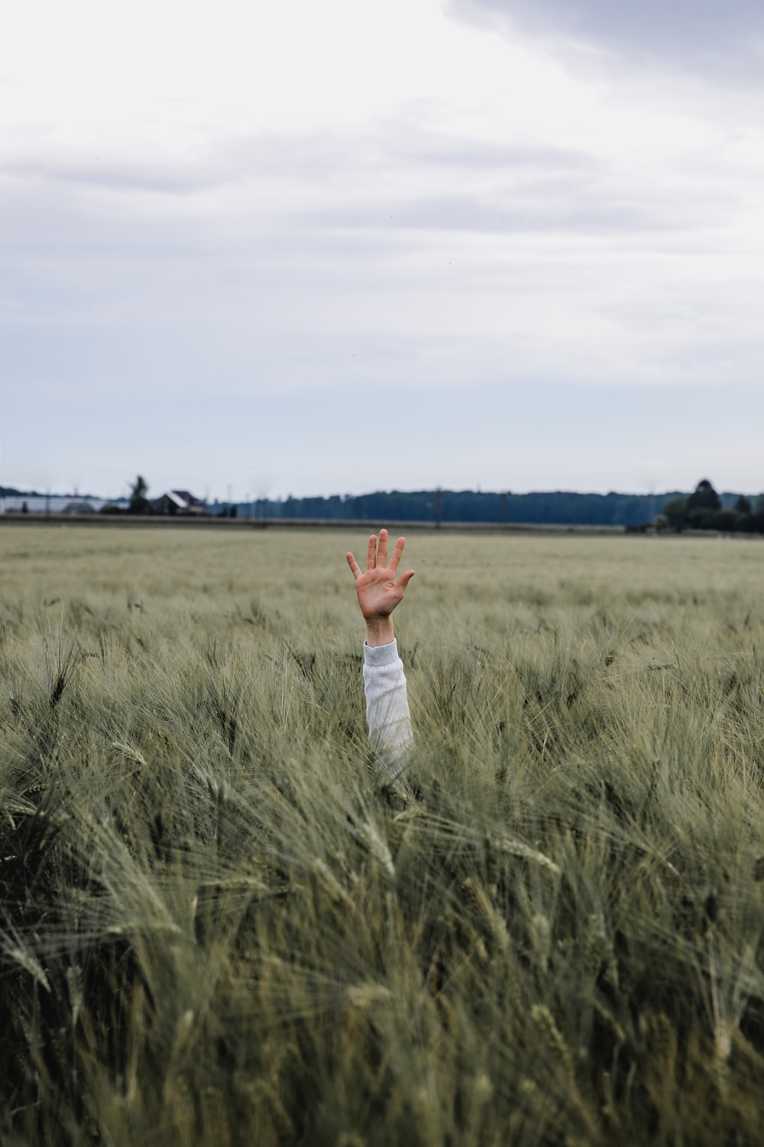
Notes:
GET OUT OF THE WEEDS

Slide 37
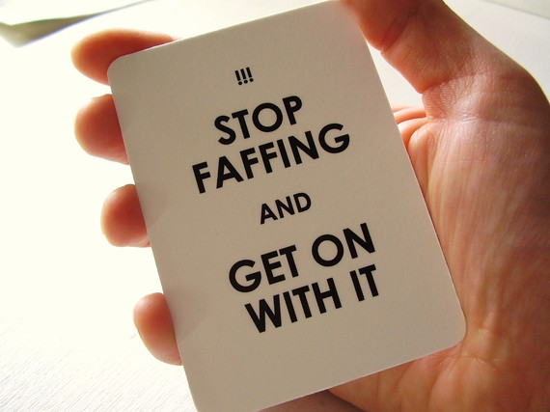

Slide 38
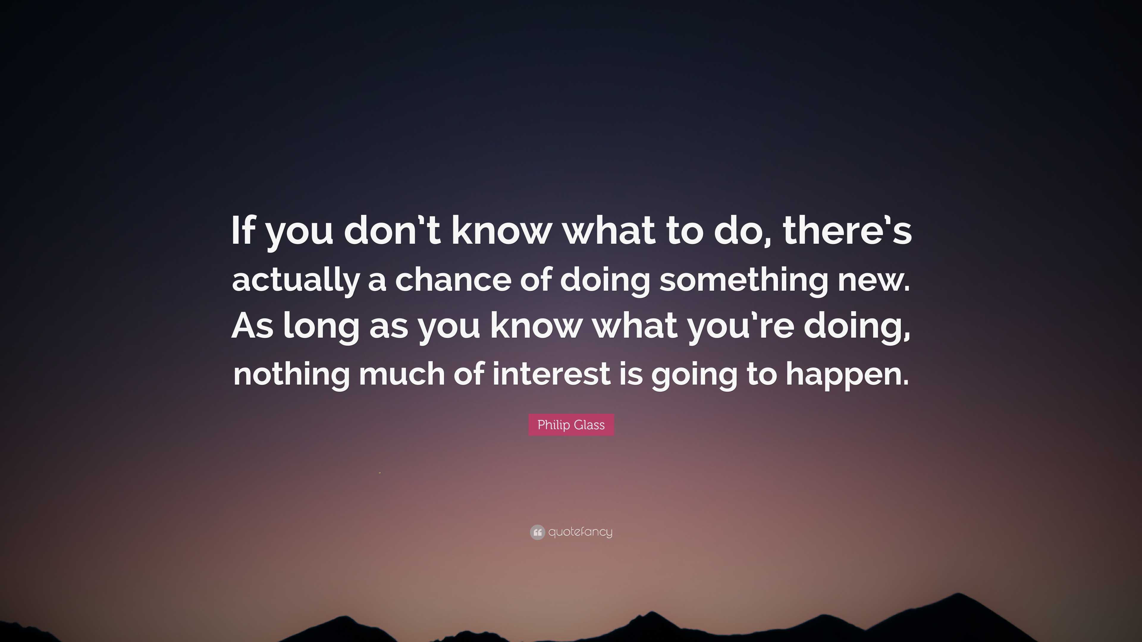

Slide 39

JAPANESE
CRISIS/OPPORTUNITY
Notes:
CHINESE – CRISIS/OPPORTUNITY

Slide 40
The greatest danger for most of us is not that our aim is too high and we miss it, but that it is too low and we reach it.
Michelangelo

Slide 41
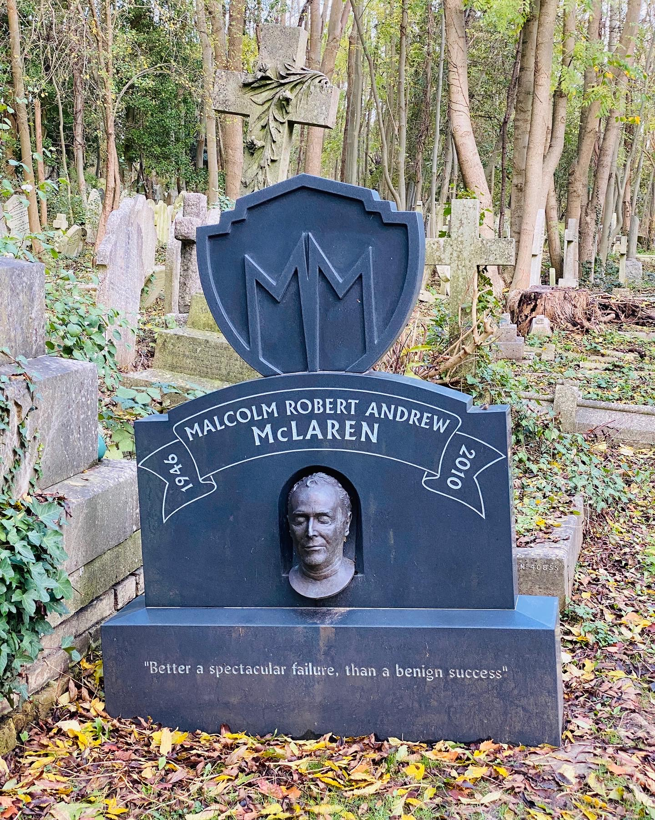
Notes:
HUMAN CONDITION IS TERMINAL

Slide 42

Notes:
PERFECTIONISM – NOT OUR FRIEND; DISCUSS *OLIVER BURKEMAN HANDOUT*

Slide 43

VR experience
Ever tried. Ever failed. No matter.
Try again. Fail again. Fail better.
Notes:
REDEFINE SUCCESS

Slide 44

Notes:
CB ANECDOTE – JOAN R
BOB M QUOTE

Slide 45


Slide 46
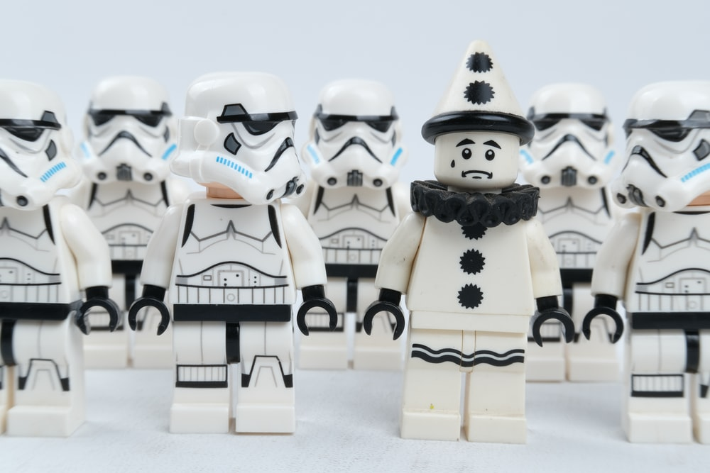
Notes:
Vulnerability – effort/effortless
UNEXPECTED – YOU DECIDE
performing – how not what, body not mind

Slide 47
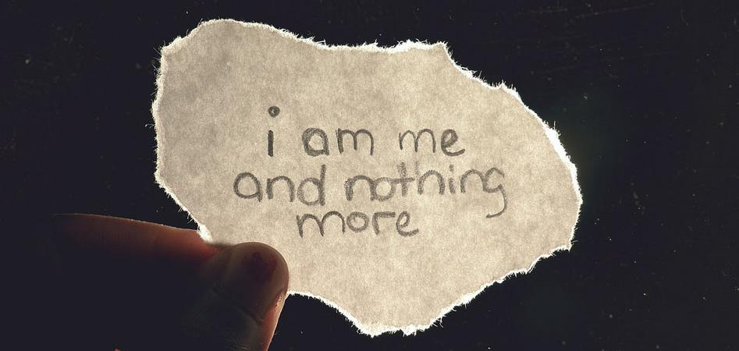

Slide 48
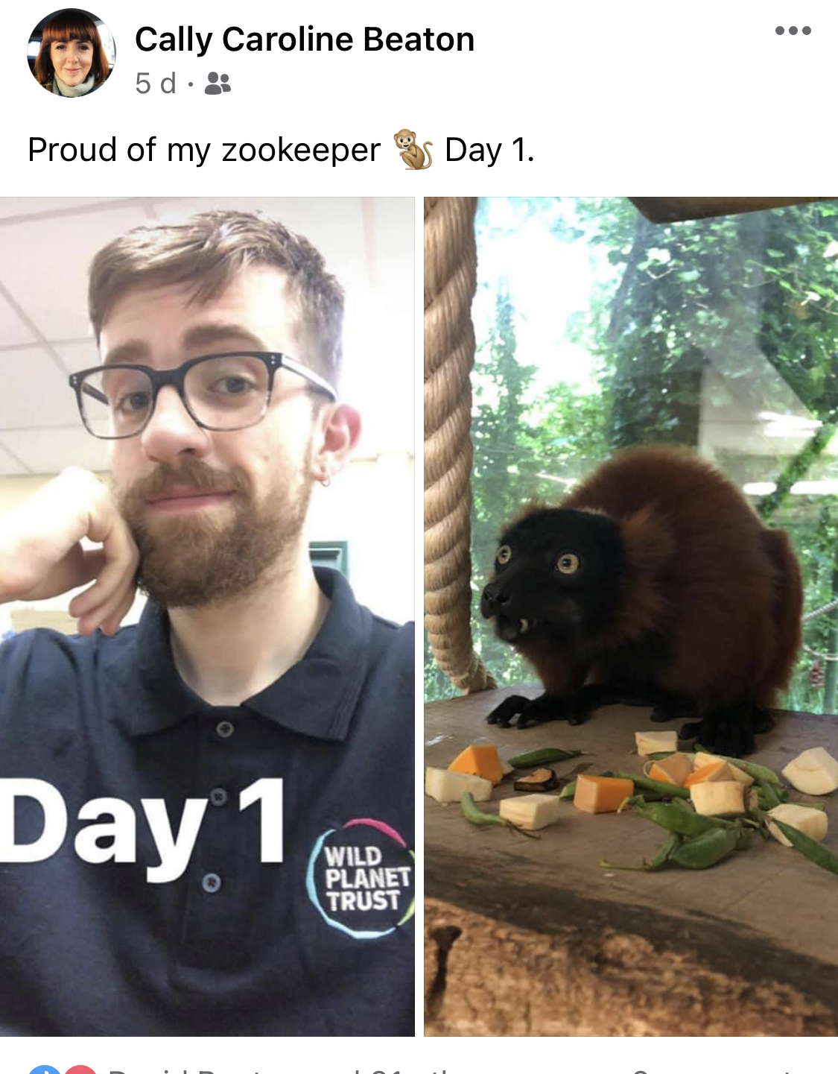

Slide 49


